Slide 1
Youth for Change – the concepts

Slide 2


Slide 3
How is the world today? (yours)
What challenges? What opportunities?

Slide 4


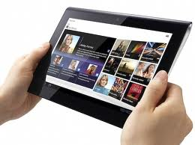

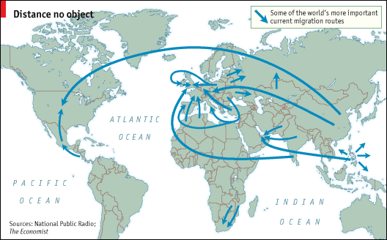

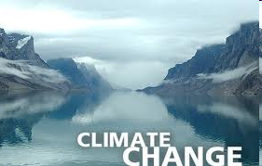
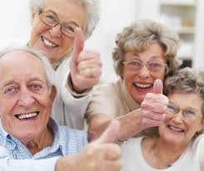
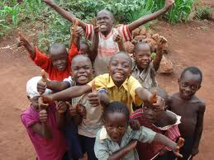

Notes:
4
4

Slide 5
Words of today...
Lack of meaning
(religion/spirituality
Innovate
Environmental issues
  Water
  Nature
  Climate
Mobility
Values
- family
Multiple membership
Connectivity
Mixing (people, cultures, …)
Social issues
Complexity
Health
Crowd sourcing
Uncertainty
Anxiety
(lack of) sense of future
Communication
Happyness
Family vs Society
Networks
Entrepreneurship
(employability)
Demography
Anxiety
Collaboration
Personal identity vs
individualism
Well-being
Pragmatism
Social position
(viewed by others)

Slide 6
How is Youth today?

Slide 7
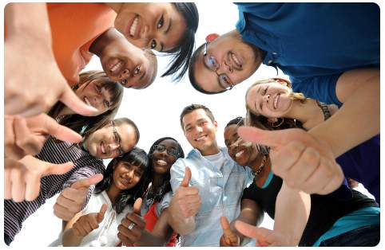
What Youth?
[McCan world group, 2011 (7000 answers in 17 countries)]

Slide 8
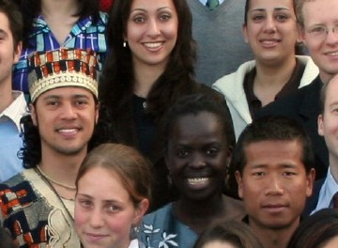
Main motivations
Commune
The need for connection, relationship and community
Justice
The need for social or personal justice, to do what’s right, to be an activist
Authenticity
The need to see things as they are

Slide 9
1. Technology as a fifth sense
technology represents:
…all the friends you could ever want,
…all the knowledge you will ever need, and
…all the entertainment you could desire.
A deep relationship with technology is shaping their attitudes towards community and truth and allowing them to re-imagine justice for a new era.

Slide 10
2. The Social economy
Experience economy vs social economy
The influence of friends
From belonging to connecting; redefining friendship
The friends “arm race”
Your audience waits…
Pics, or didn’t happen
Creativity and competition

Slide 11
3. The truth hunters
Truth is very important
Idols came down to earth
Fame? Depends where you live…
Brands of substance

Slide 12
4. Justice re-imagined
Social media and justice (and activism)
Re-imagining personal justice
Don’t promise what you can’t deliver

Slide 13
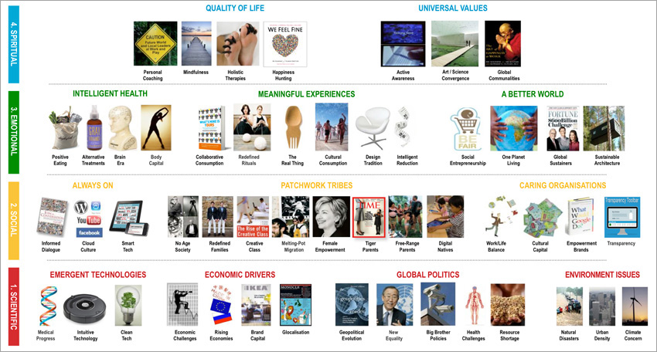
Tomorrow?... (Trend Atlas, Anne Lise Kjaer)

Slide 15
Can young people make a better world?

Slide 16

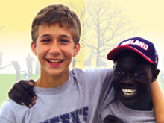
Ryan Hreljac, 6
Canada

Slide 17
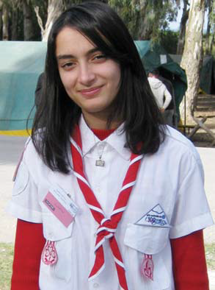
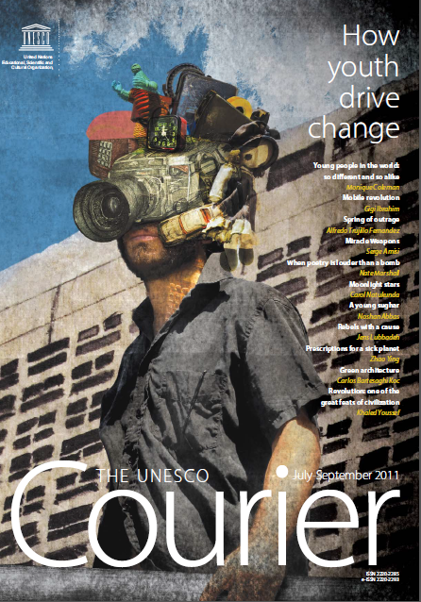
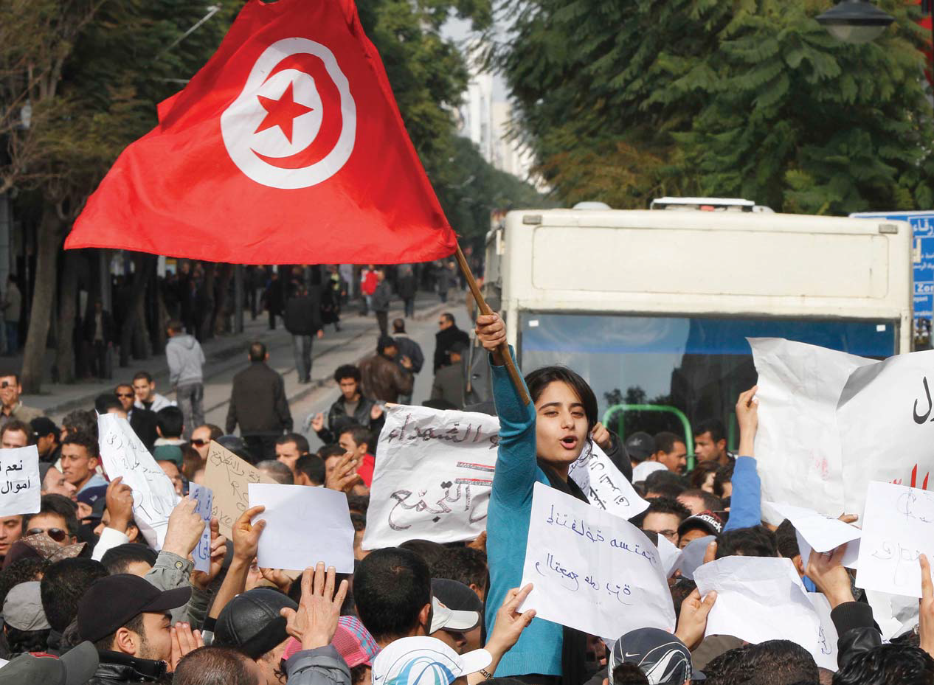
Emna Fitouri, 21
Tunisia
“Our future actions will be part of a process of building a new country”

Slide 18

Youth for Change: why?

Slide 19
We believe…
Youth can be a tremendous source of energy, creativity and values that can shape a better future, both inside Scouting and in the World, through action in the local communities in which young people live in.

Slide 20
Youth for Change
Youth in decision making
Intergenerational dialogue
Youth changing communities
Skills for life
Scouting
World

Slide 21
Youth Participation, Youth Empowerment, Youth Leadership, Active Citizenship, Intergenerational dialogue, Advocacy, Peer Education…
Youth in decision making | how can we have youth participating more? what preparation should we provide?
Intergenerational dialogue | how can we encourage better dialogue and cooperation between generations? what should be the adult leader role?
Youth changing communities | can youth be active agents of change TODAY? what can they do? (or are doing)
Skills for Life | what skills should Scouting provide for young people to have na impact? how can we better empower youth?

