Slide 1


Slide 2

Safe from Harm: From talking to walking

Slide 3

ID of Module 4
To introduce basic rules, techniques and approaches in SfH.
Aim
By the end of the training module participants:
will understand the importance of the SfH practices;
will implement them in their regular scout practice.
Learning objectives
Approximately 90 minutes
TRAINING
MODULE 4
The purpose of Safe from Harm

Slide 4
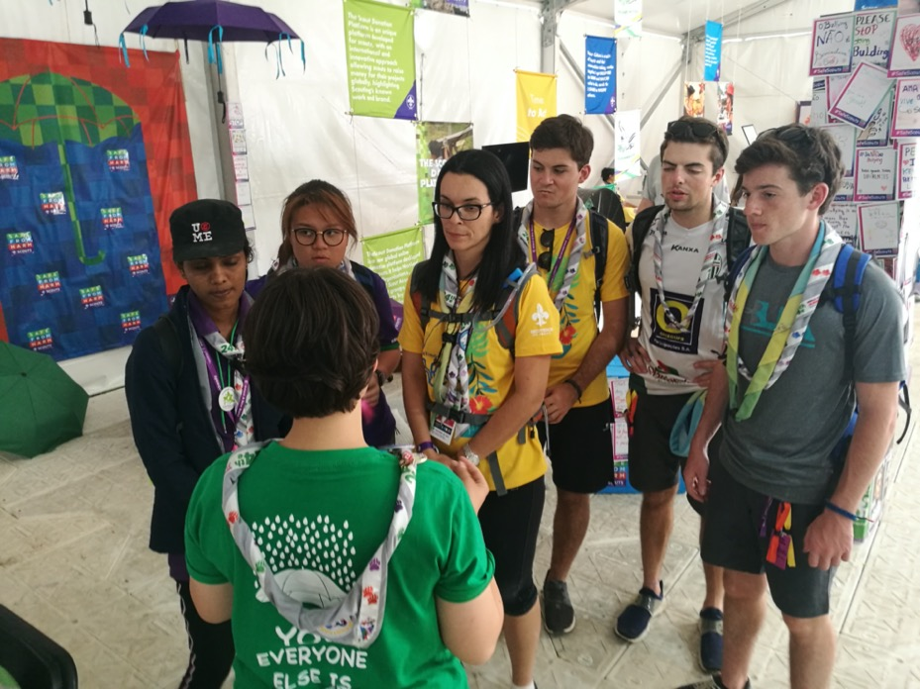
Are you familiar with any Safe from Harm practice?

Slide 5
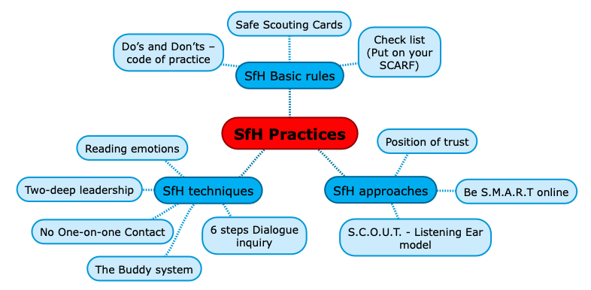
SfH practices examples

Slide 6
1. Exploration
Read the description of the practice and share experience they have with the practice. If nobody has any previous experiences, facilitator can introduce it to the group.
Work in small groups

Slide 7
1. Exploration
2. Animation
Small group findings
Play-out of some rules, techniques, approaches

Slide 8
Sharing other ideas
What other rules, techniques and approaches can we identify in our practices?

Slide 9
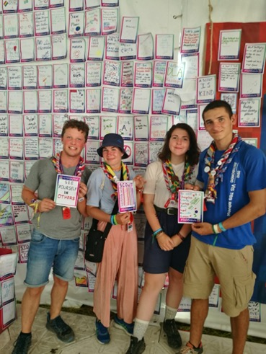
Sharing and communicating SfH practices
Workshops for skills development;
Dedicated NSO SfH page;
SfH forum open to all and for all;
Awarding system for the SfH compliance;
Seminar for some stakeholders: parents, teachers, social workers, etc;
Messaging practices through media channels

Slide 10
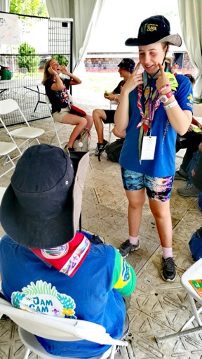
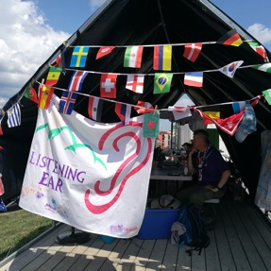
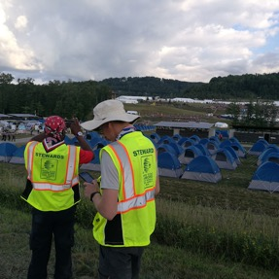

Safe from Harm practices are the most evident part of our SfH efforts.

Slide 11
Thank you for making Safe from Harm a reality!

