Slide 1


Slide 2

The purpose of
Safe from Harm

Slide 3

ID of Module 2
To provide an outline of Safe from Harm in World Scouting.
Aim
By the end of the training module participants:
will have general overview about Safe from harm in the present world context,
will have a deeper insight in the development of the Safe from Harm in Scouting,
will know the tools for supporting Safe from Harm development,
will understand how they can contribute towards Safe Scouting.
Learning objectives
Approximately 90 minutes
TRAINING
MODULE 2
The purpose of Safe from Harm

Slide 4
According to you why is the concept of Safe from Harm important?
Brainstorm together !!

Slide 5
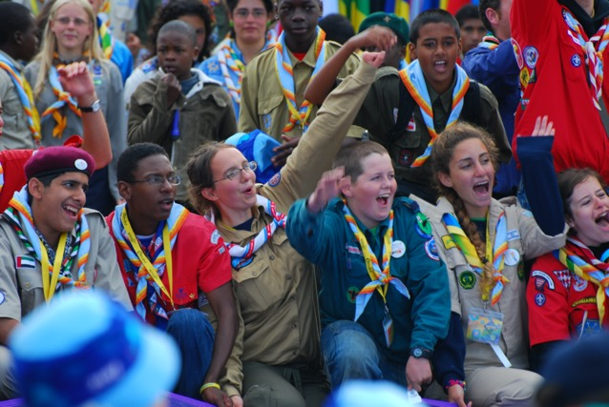
Safe from Harm brings positivity!
It is fundamental right of every person to be safe
Providing a safe environment where young people can be empowered and where they can have a positive and better experience in Scouting
SfH also protects the NSO, the adult leader and other supporters of Scouting

Slide 6
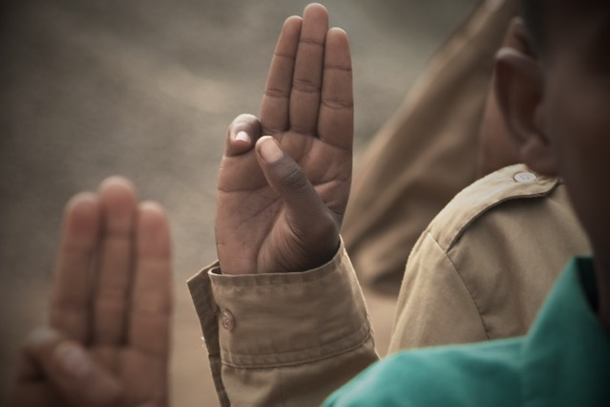
Being Safe from Harm and protected from abuse
e.g. historical child abuses cases
The negative effects on young people
The negative effects on NSOs as a result of a catastrophic event - PR, membership, financial impact

Slide 7
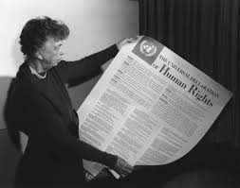


Essential resources to better understand Safe from Harm…
UN Declaration of Human Rights 1948
UN Convention on the Rights of the Child 1989/1990
Keeping Scouts Safe from Harm resolution by the World Scout Conference in Thessaloniki 2002

Slide 8
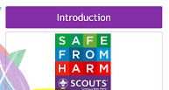


Essential resources to better understand Safe from Harm…
Safe from Harm training for the World Scout Jamboree (UK 2007, Sweden 2011, Japan 2015)
Keeping Scouts Safe from Harm - WOSM position paper 2014
Safe from Harm World Policy, Baku 2017

Slide 9




WOSM tools to keep young people safe!
World Safe from Harm policy
Safe from Harm e-learning modules
Safe from Harm educational tools e.g Anti-bullying toolkit, Safe from Harm videos
Guidelines and self-assessment for National Scout Organisations
WOSM Safe from Harm Service
Safe from Harm in world and regional events

Slide 10
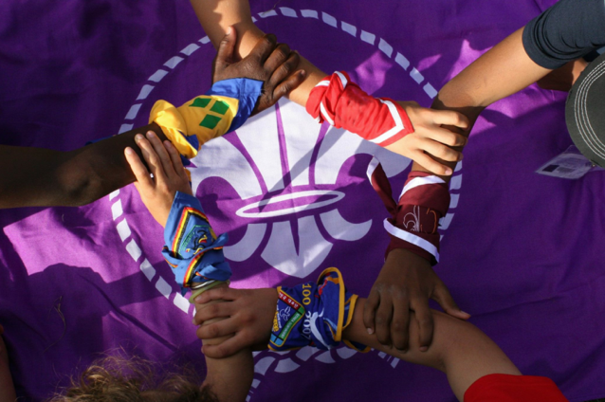
Safe from Harm and the image of Scouting
Creating a safe environment for all, allowing young people to feel self-fulfilled and grow in a healthy environment
Empowering young people to stand up for their rights and safety
Connecting with other organisation for support and common actions
Essential for the credibility of the movement

Slide 11
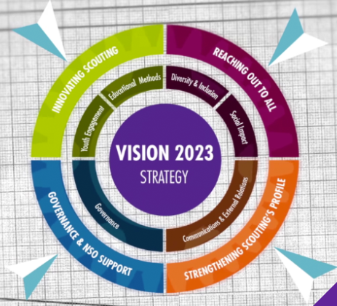
Implementing Safe from Harm to create a positive change!
By aligning with and working towards the Mission and Vision of Scouting
By helping to strengthen the core mission of Scouting and provide better Scouting experiences and non-formal education,
By ensuring that Scouting takes an active role in promoting child and youth protection within local, national and international communities,
By encouraging active citizenship through the development of values, competencies and behaviours of individuals.

Slide 12
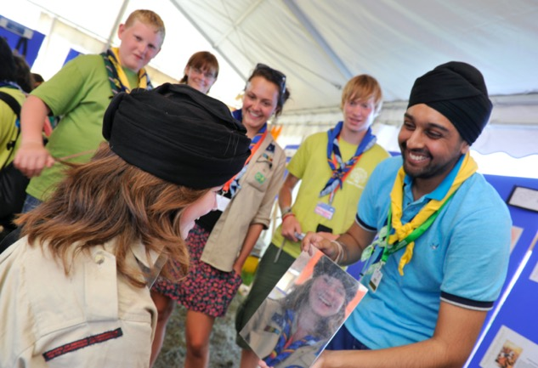
Take part in creating a safe Scouting environment
All young people aware of Safe from Harm;
All leaders trained in Safe from Harm;
NSOs have a Safe from Harm policy and robust systems for reporting, management and resolution of Safe from Harm concerns;
NSOs put in place all measures during the events;
Scouting establishes meaningful partnerships with others.

Slide 13
Thank you for making
Safe from Harm a reality!

