Slide 1


Slide 2

What is Safe from Harm?

Slide 3

ID of Module 1
To introduce the Safe from Harm and to raise the understanding of the SfH basics.
Aim
By the end of the training module participants:
will be familiar and know about World Safe from Harm Policy and other useful resources,
will identify different types of abuse,
will understand the position of trust between educator and educated.
Learning objectives
45 minutes
TRAINING
MODULE 1
What is Safe from Harm

Slide 4

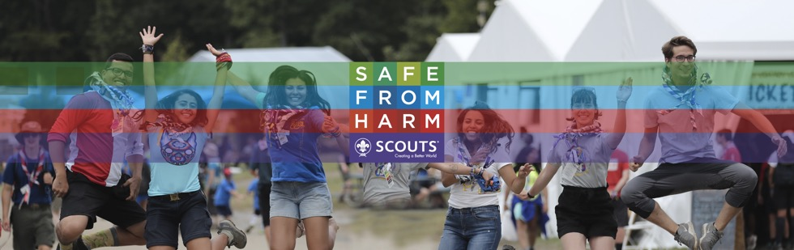
For you what is Safe from Harm…?
Do a quick brainstorming with your group on a white board

Slide 5

Discover Safe from Harm…

Slide 6

World Safe from Harm Policy
Created in 2017, the World Safe from Harm policy sets minimum level of implementation of procedures and actions Scouts will take, to create a safe environment for everyone, and at all times.
It is applicable to all Scouts around the world and each National Scout Organisation/Association is responsible for its application at the national and local level

Slide 7
Key words to better understand…
Link the right word with the right definition.
Safe from Harm
safe environment
Child and Youth Protection
Abuse
This term is used to define the safeguarding and the promotion of the welfare of children and young people
Encompasses all the areas of child and youth protection and includes a full range of strategies, systems, procedures that aim to promote the well-being, development and safety of children and young people as a priority in Scouting-related activities
This term is used to describe a range of ways in which maltreatment can be inflicted to children and young people
Promotes and supports children and young people’s well being, while simultaneously working to address and prevent harmful practices

Slide 8
Key words to better understand…
Answers
Safe from Harm encompasses all the areas of child and youth protection and includes a full range of strategies, systems, procedures that aim to promote the well-being, development and safety of children and young people as a priority in Scouting-related activities.
Abuse is used to describe a range of ways in which maltreatment can be inflicted to children and young people.
Child and Youth Protection defines the safeguarding and the promotion of the welfare of children and young people.
Safe Environment promotes and supports children and young people’s well being, while simultaneously working to address and prevent harmful practices.

Slide 9
Understanding the different types of abuse
Physical abuse of a child is when an adult causes any non-accidental physical injury to a child. There are many signs of physical abuse. It includes striking, kicking but also sexual touching or any other action that injures a child. Even if the adult did not mean to cause injury, when a child is injured it is abuse. Emotional or psychological abuse: When an adult harms a child’s mental and social development, or causes severe emotional harm, it is considered emotional abuse. While a single incident may be abuse, most often emotional abuse is a pattern of behaviour that causes damage over time.

Slide 10
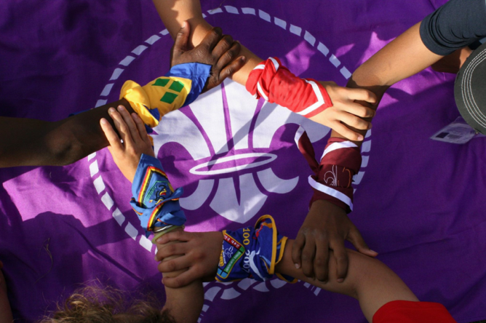
For whom is this policy?
EVERYONE! All Scouts are concerned by Safe from Harm but here are the different targeted audiences:
Children and young people between 5 and 26 years of age,
Adult volunteers and professional staff,
Any and all external stakeholders involved in supporting Scouting.

Slide 11
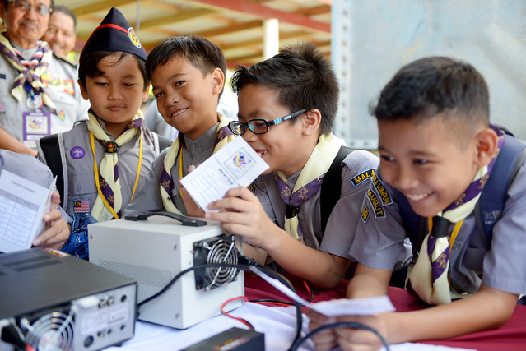
Abuse exists at every levels…
It is important to keep in mind that abuse can occur anywhere, and that the perpetrator and the victims can not always the same. It can occur:
From an adult towards a young person or a child
Between two young person
Between two adults

Slide 12
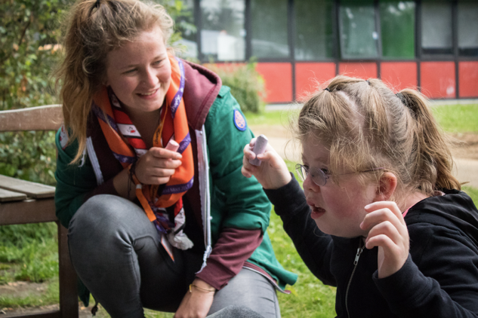
Being in a position of trust
Children and young people will look up to you as a person of high integrity and will always expect the highest possible standard from you :
Children should be treated with dignity and respect and should rely on you to ensure their safety and well being
You should not use the position of trust to get involved in inappropriate relationship with them
It is our responsibility to raise awareness on SfH to ensure a Safe Environment at all times

Slide 13
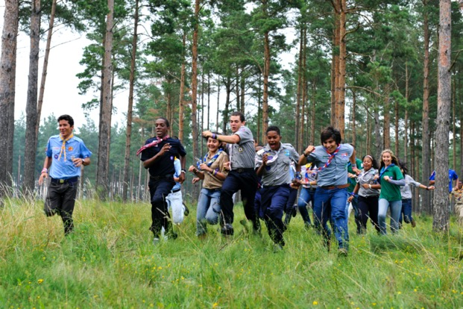
Providing a safe environment encompasses
Educational purpose of Scouting activities,
Safety in Scouting activities,
Development of personal skills,
Involving all stakeholders (e.g. children and young people, adult volunteers and professional staff, parents, school authorities, faith-based organisations),
Creating and awareness, promoting and encouraging positive behaviour.

Slide 14
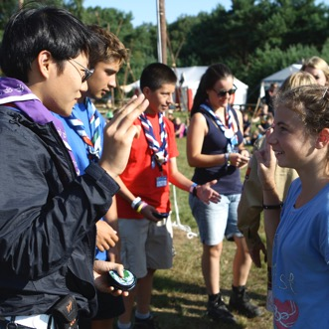
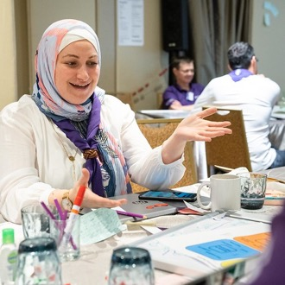
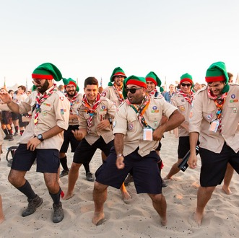
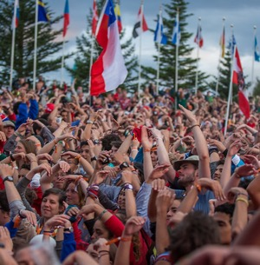

Areas of implementation
Youth Programme
Adults in Scouting
Scouting events

Slide 15
Thank you for making Safe from Harm a reality!

