Slide 1


Slide 2
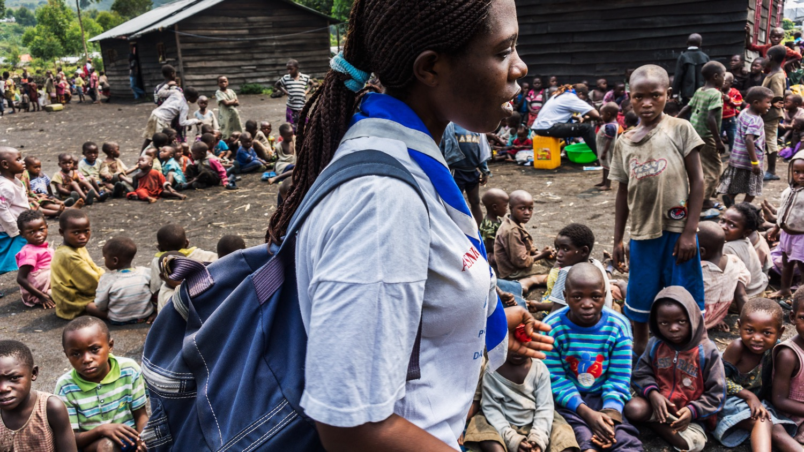

Scouts of the World
Award
YOUTH PROGRAMME

Slide 3
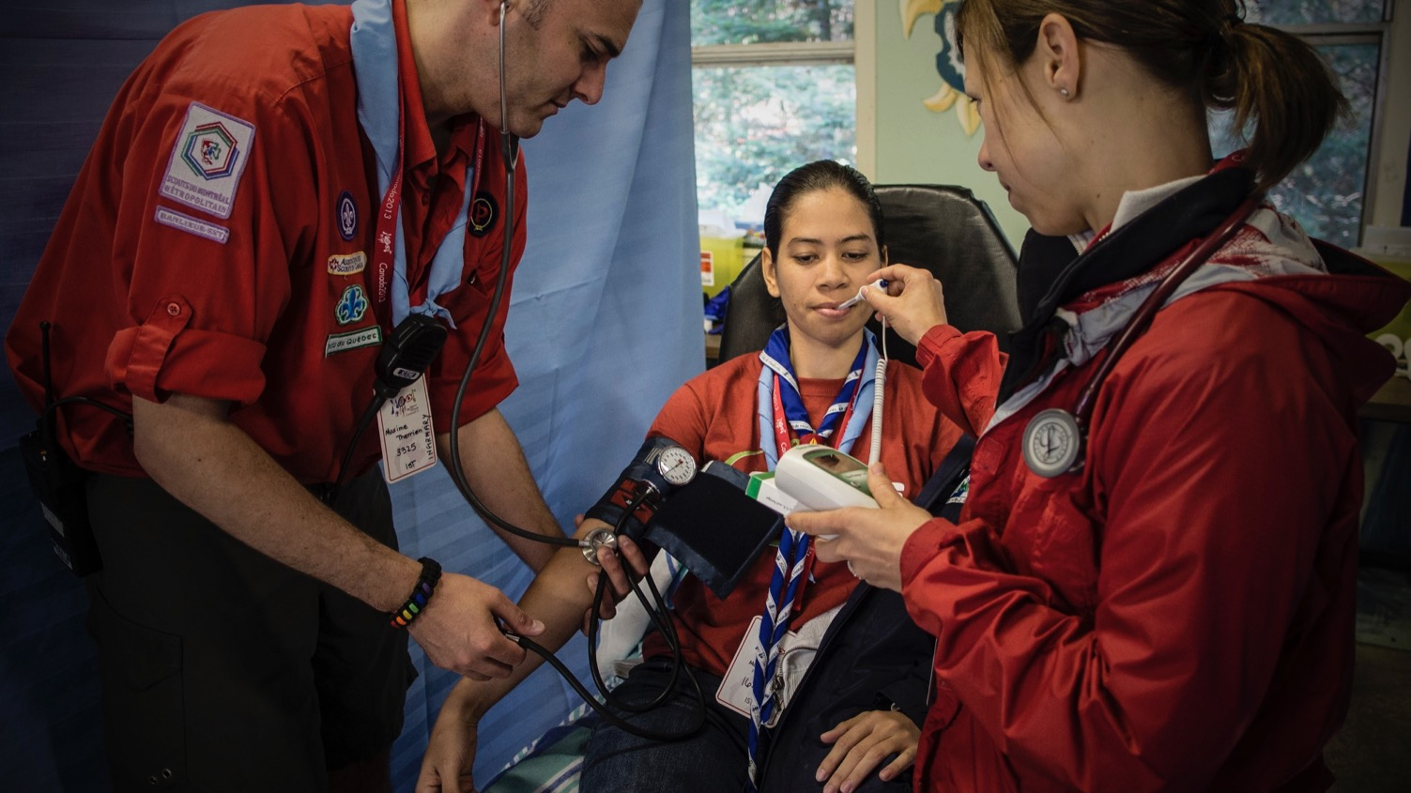
The Scouts of the World Award challenges all young people, Scouts and non-Scouts, to think about global issues and act upon them in their local community.
It is the only award for young people provided by World Scouting. As part of the learning experience, you can gain the knowledge, skills, and attitudes needed to help solve global issues at local level.
The award requires a commitment from you to make your community a better place. On completion, you will be part of a network that provides inspiration to others to take action!
Introduction

Slide 4
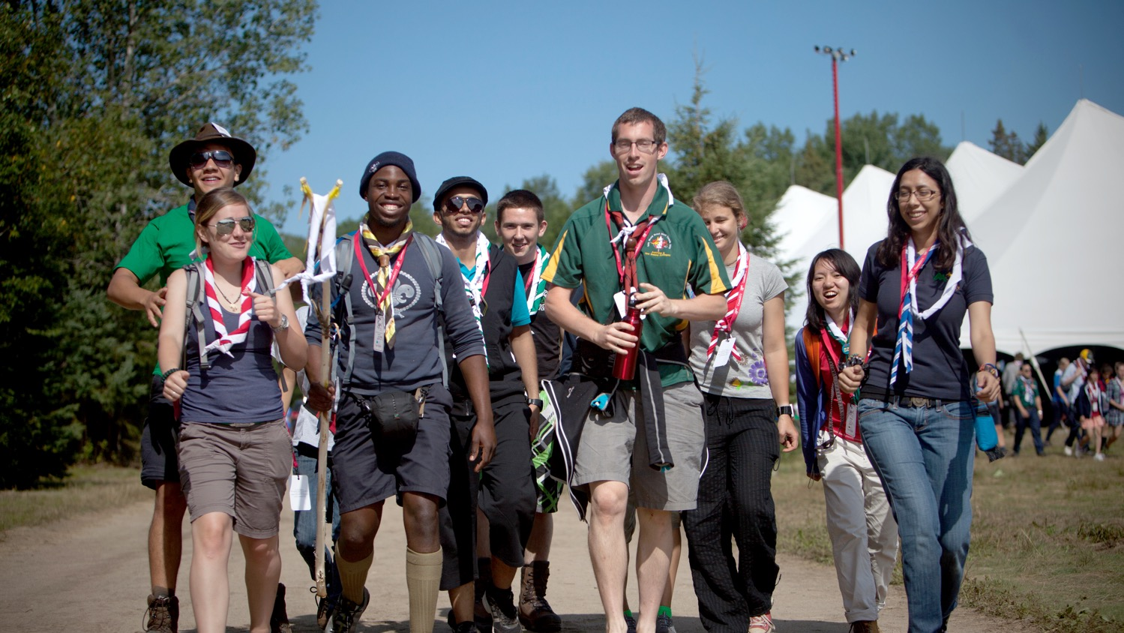
In 2004, appreciative of its partnership with the UN, the World Organization of the Scout Movement (WOSM) signed an agreement with the UN to contribute actively to the MDG campaign. The Scouts of the World Award (SW Award) was launched to encourage thousands of Scouts and non-Scouts to adopt world citizenship.
History

Slide 5
It offers an educational framework to understand a global challenge and run a voluntary service, long-term development project to act on this challenge at local level. While the purpose of the award fundamentally remains educational, it also seeks to impact society.
We will constantly monitor the new, post-2015 UN sustainable development goals (SDGs) and continuously aim to actively address them year after year along with other local and international developmental goals.
History

Slide 6
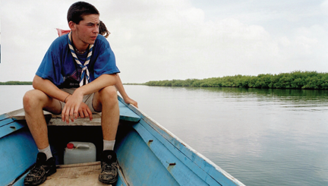
Fields of Action
From the MDGs, WOSM chose three areas to focus on with the SW Award: development, peace, and the environment. These three fields for action frame the projects run by Scouts and non-Scouts pursuing the SW Award.

Slide 7
Fields of Action
Development – change, growth, or improvement over a period of time.
Peace – a situation in which there is no war between countries or groups.
Environment – the natural world including land, water, air, plants, and animals especially considered as something that is affected by human activity.

Slide 8
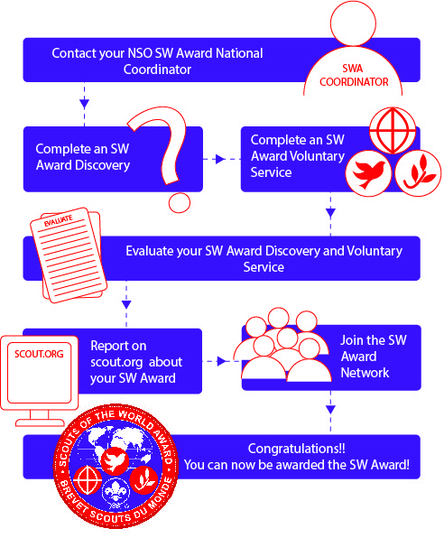
SW Award Programme
v
The SW Award consists of three components:
The SW Award Discovery (Exploring and Responding)
The SW Award Voluntary Service (Taking Action)
The SW Award Network (Just the Beginning)
Notes:
The SW Award is granted to individuals who have successfully accomplished an SW Discovery, an SW Voluntary Service, and joined the SW Award Network.

Slide 9
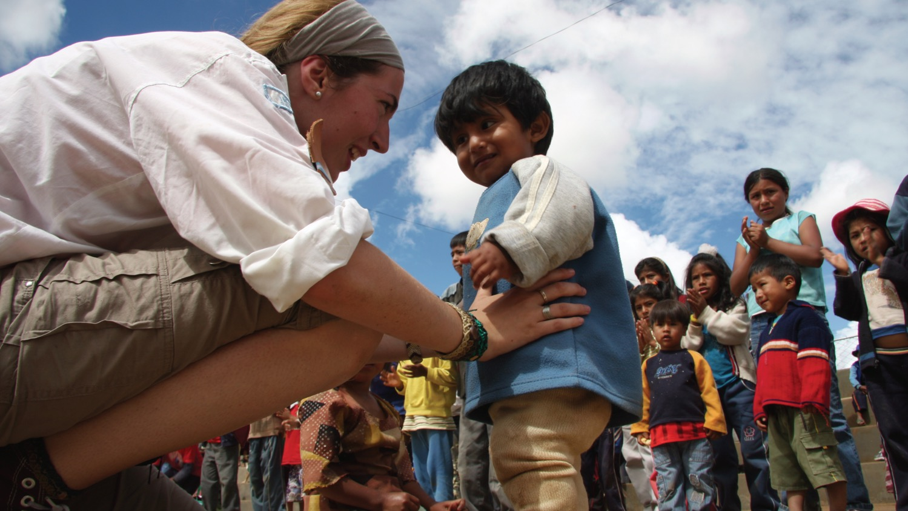
SW Award Discovery
The SW Discovery is the first stage in the process of the SW Award Programme. It will give you an opportunity to explore and discover an issue faced by your local community.
Once you understand the challenge, you can respond to what you have discovered. You then research and see how it impacts you and your community.
Finally, once you’ve acquired the relevant skills during our training workshops, you can start planning a service project designed to address this challenge.

Slide 10
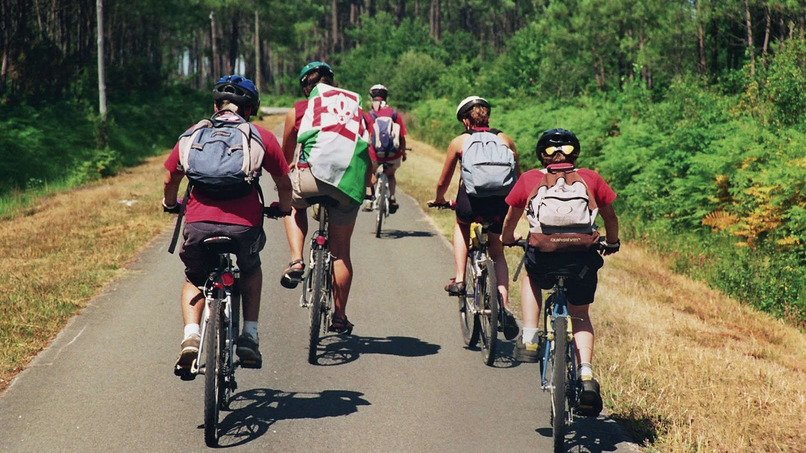
SW Award Discovery - Objective
Become familiar with the stages of the SW Award Programme (Discovery > Voluntary Service > Network > Award).
Actively understood the entire context of a local situation where a community is facing issues related to development, peace, and/or the environment.
Developed a feeling of empathy and personal commitment regarding these issues.
Set up a personal plan of action in order to play an efficient role in increasing awareness and helping communities facing such issues.
Started to plan your service project (SW Voluntary Service).

Slide 11
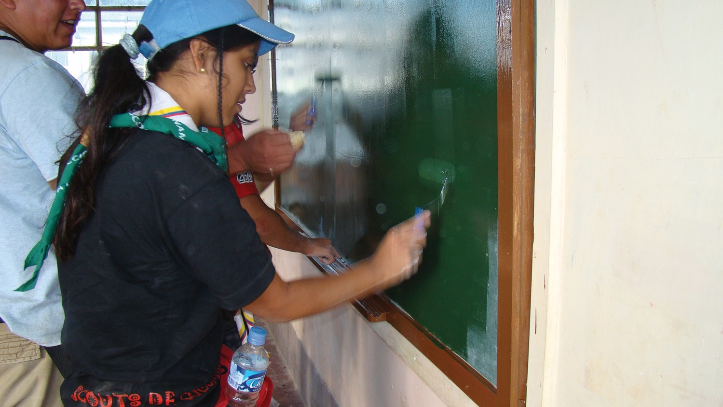
SW Award Discovery - Layout
An SW Discovery lasts a few days (a minimum of 21 working hours).
Exploring:
In the first step of the SW Discovery, you will explore a specific issue related to development, peace and/or the environment. By interacting with the local community you will begin to understand its complexities.

Slide 12
SW Award Discovery - Layout
Responding :
In the second step of the SW Discovery, you will respond to what you have experienced during the exploration phase. You will then process all the collected information, and digest, debate, and understand the causes and the consequences of the issue at stake.

Slide 13
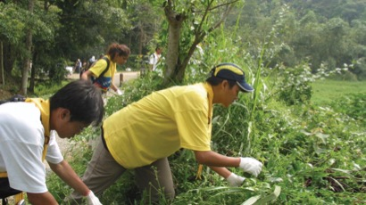
SW Award Discovery - Summary
Attend an SW Discovery, which can take place in a registered permanent or temporary SW Award Base or another appropriate site.
Validate your SW Discovery by achieving the objectives described earlier and having these achievements assessed.
Use your SW Award Passport to keep record of your experiences in preparing for the SW Award. Completing the passport stages will lead you towards the SW Award itself.

Slide 14
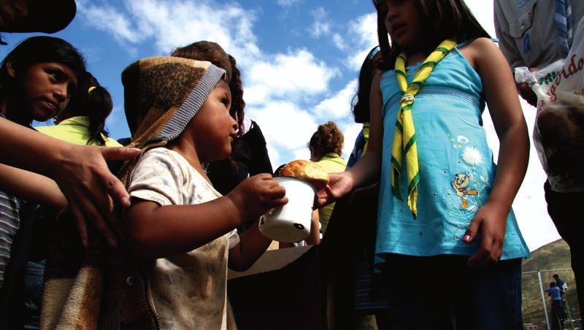
SW Award Voluntary Service
Once you have completed your SW Discovery. Now you need to do a period of voluntary service in order to contribute to solving a problem related to development, peace, or the environment. An SW Voluntary Service is a period of personal commitment where you develop a long-term (a minimum of 80 working hours) community project.
Notes:
While your project will most certainly address a specific local issue, bear in mind that you are contributing to tackling a global challenge.

Slide 15
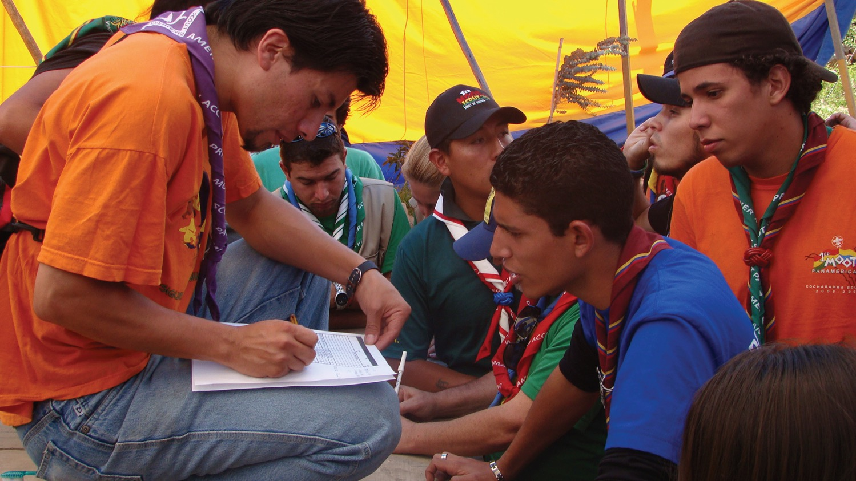
SW Award Voluntary Service - Objective
Transform your commitment into action moving towards active world citizenship.
Reinforce your project management skills as well as your knowledge of project dynamics.

Slide 16
SW Award Voluntary Service - Objective
Contribute to solving a specific issue related to development, peace, or the environment while increasing the awareness of the local community regarding this issue.
Create an opportunity for Scouting to reinforce its capacity as a social agent, as well as to develop its partnerships with other organisations and community leaders

Slide 17
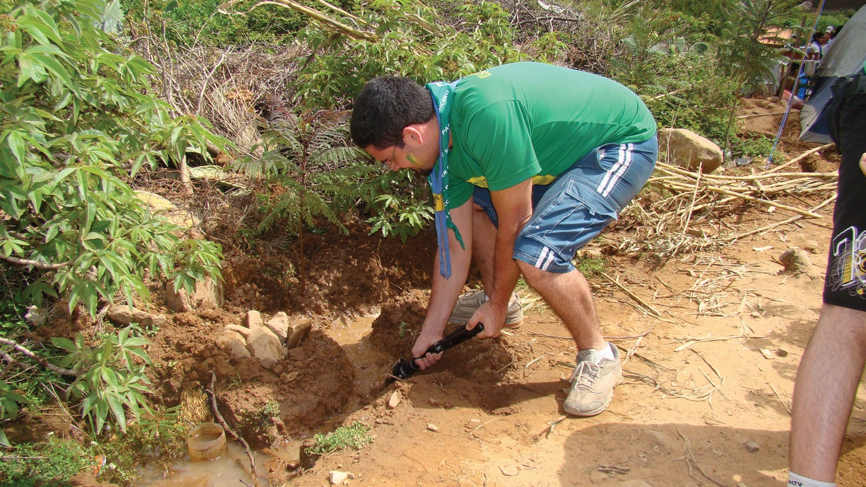
SW Award Voluntary Service - Layout
Your SW Voluntary Service will focus on the project that you have started to plan at the end of your SW Discovery (or related to what you have already drafted).

Slide 18
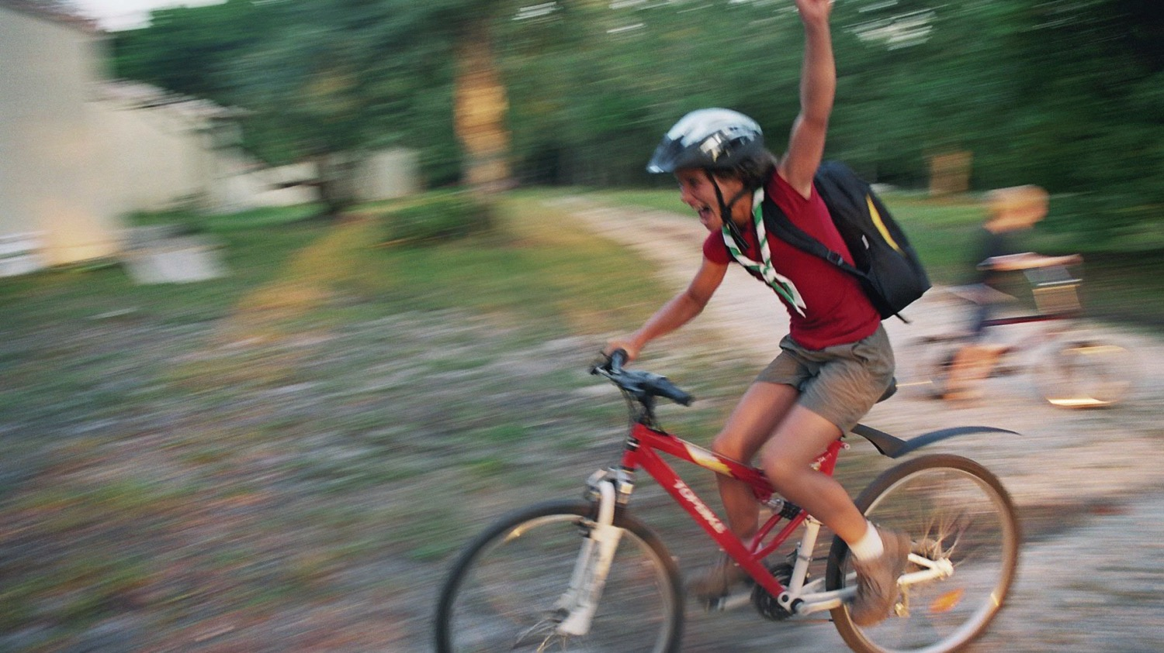
SW Award Voluntary Service - Form
An SW Voluntary Service can take two forms:
1. Planning and implementing a project with a team of friends.
Example: A team of Rovers develops a campaign in their university to prevent drug abuse.

Slide 19
SW Award Voluntary Service - Form
An SW Voluntary Service can take two forms:
2. Working to support an existing project launched by the Scout Movement or another organization.
Example: A sub-project with our partner UNESCO World Heritage within one of the designated projects by World Heritage Volunteers

Slide 20
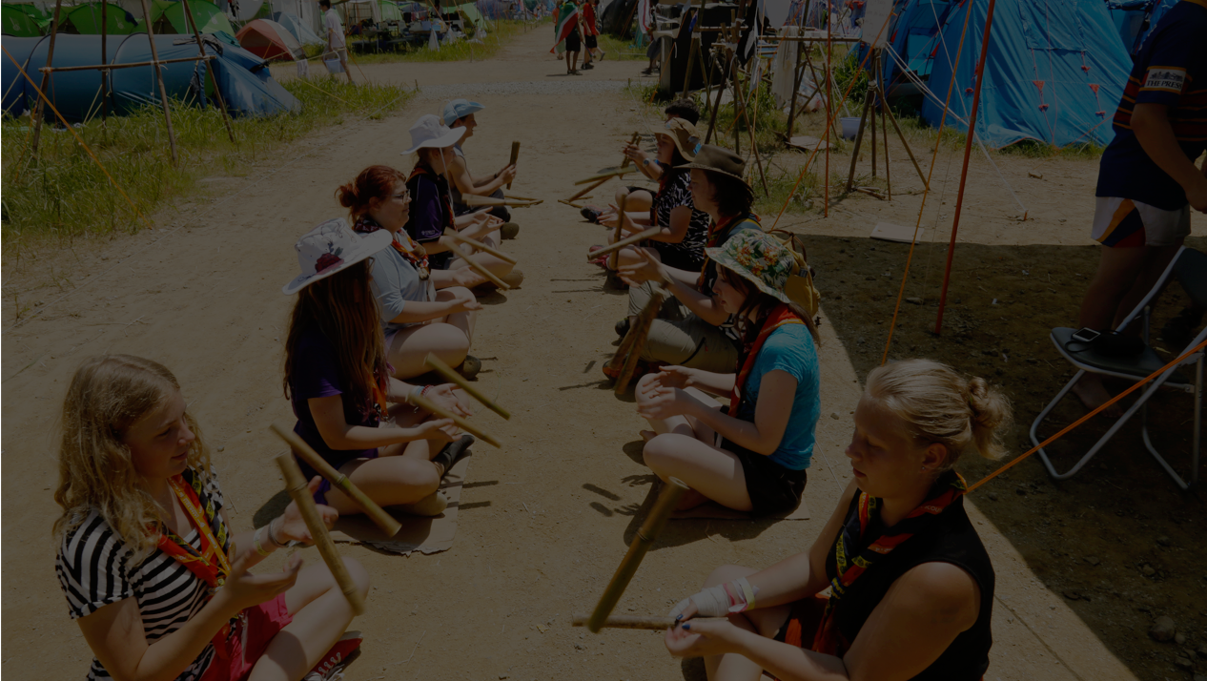
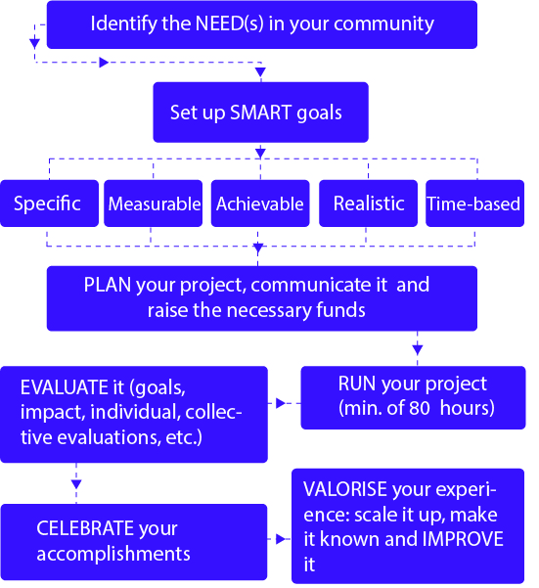
SW Award Voluntary Service - Planning
Notes:
In terms of preparation, it is recommended that start to prepare your SW Voluntary Service at the end of your SW Discovery. Take whatever time you need to develop your project, to communicate it, and, if necessary, to raise the funds you need to carry it out. The knowledge and skills needed to do this planning work are similar to those needed for any other project:

Slide 21
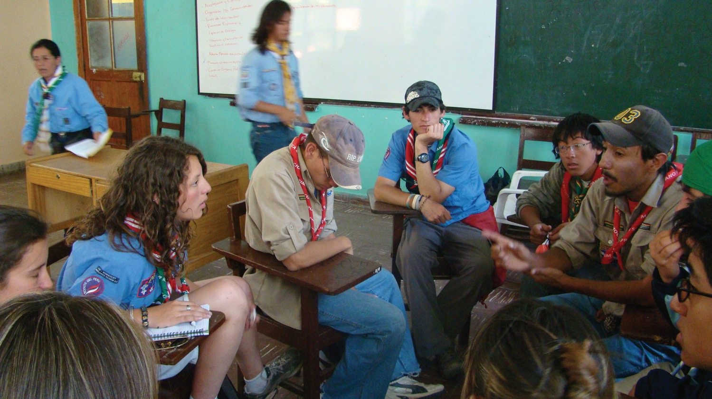
SW Award Voluntary Service - Summary
A service project should respect the following criteria:
A voluntary action commitment
A concrete and individual action
A project that fits into the Scouts of the World educational process
A significant duration
A real service to the community
Make a difference
A training experience

Slide 22
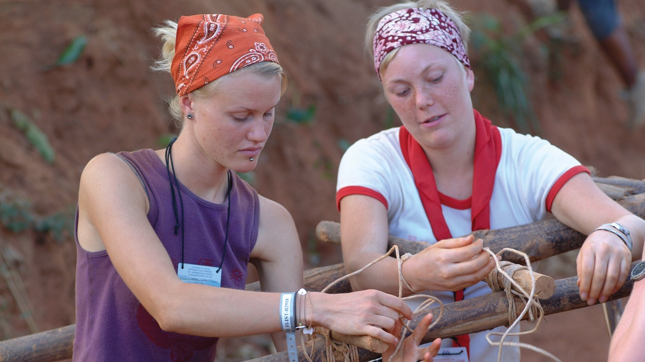
SW Award Network
Once you have finished the SW Discovery and the SW Voluntary Service you can join the SW Award Network. You can then be part of a network of young people committed to making a difference. How empowering is that? Only together can we be the change we want to see in the world.
Together with Messengers of Peace and the World Scout Environment Programmes, we can make a difference.

Slide 23
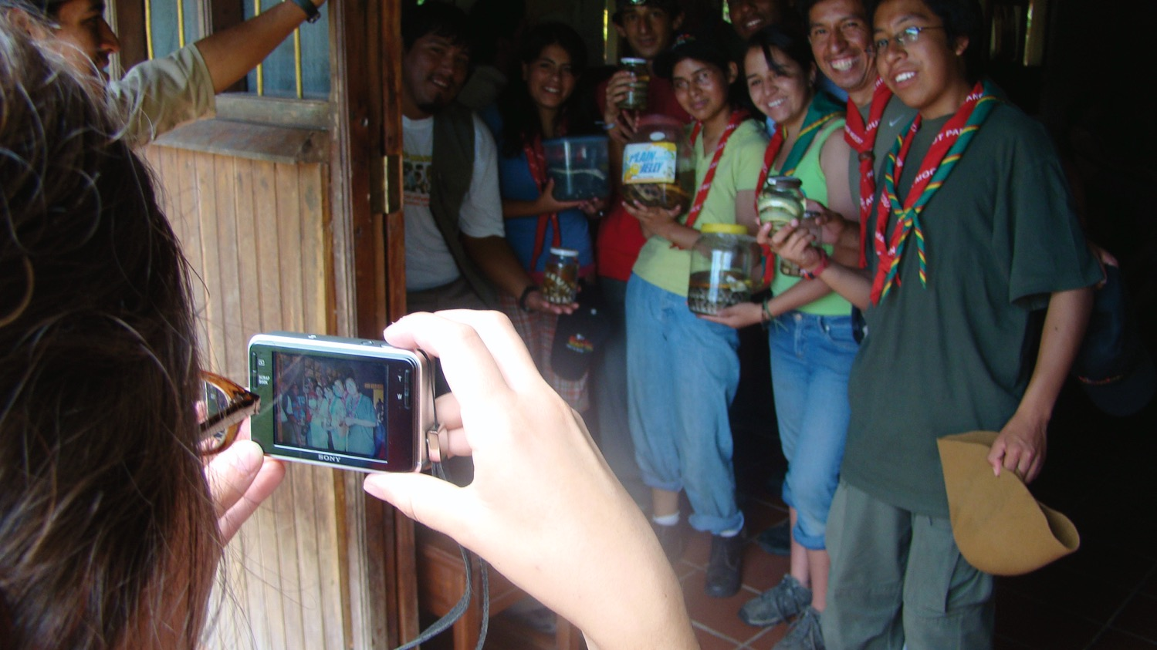
SW Award Network - Objectives
Like any other network, the SW Award Network will work if it is useful. Its usefulness remains its key objective. The objectives of the SW Award Network can be divided into two different categories of focus: an SW Award Programme focus and a Better World focus.

Slide 24
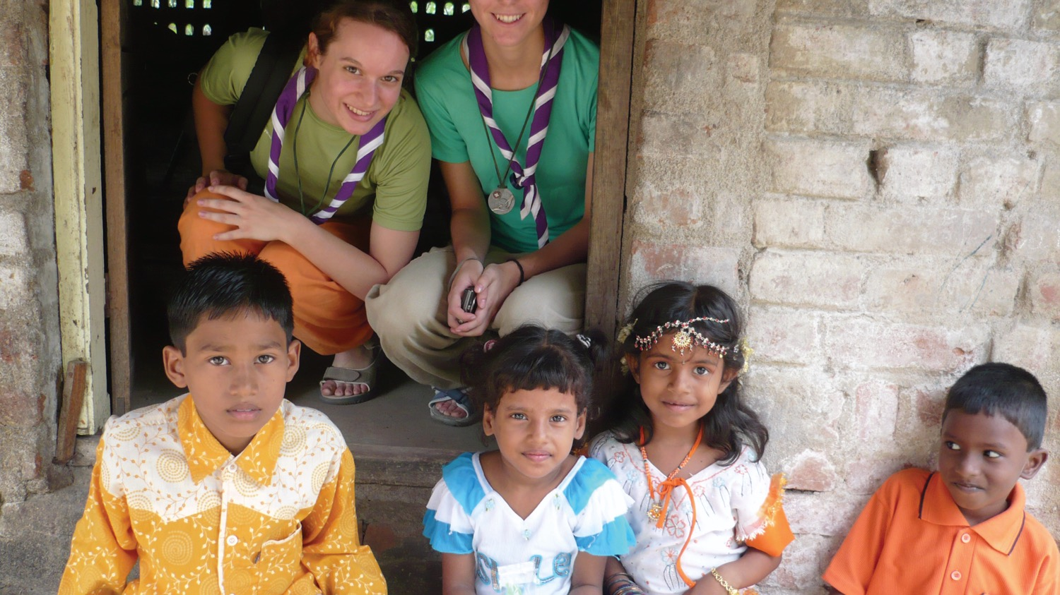
SW Award Network - Layout
To become a member of the SW Award Network, you must have completed the SW Discovery and an SW Voluntary Service. You can then join the Network by creating an account on scout.org and report the details of your project to WOSM. After that you can join the Scouts of the World Award - Network (Official Group) Facebook group.
Notes:
It is a closed Facebook group addressed to awardees only. Your SW Award Programme Coordinator can add you to this closed group. To aid communication, there is a Facebook page that is open to everyone so they can be kept up to date with the programme.

Slide 25
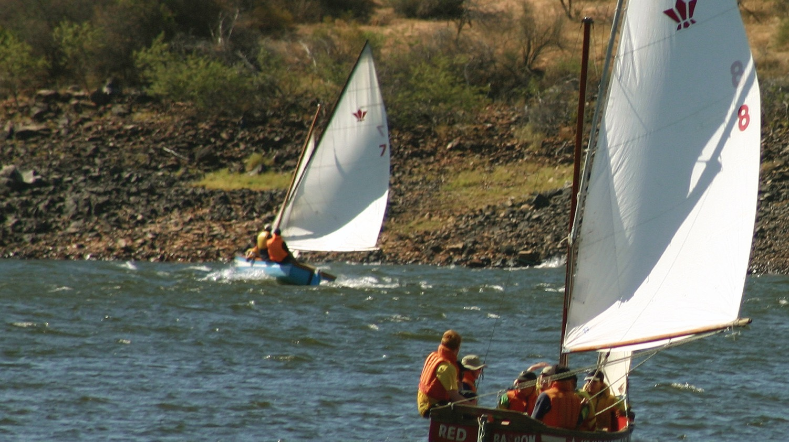
SW Award Network - Summary
The SW Award Network is open to young people who have obtained the SW Award. While its scope of action is very large, its contributions should remain closely linked to the SW Award Programme or to issues related to development, peace, and the environment.
Notes:
The objectives presented above might help. Members of the SW Award Network should not consider themselves an elite but as agents at the beginning of their journey to contributing to building a better world.

Slide 26
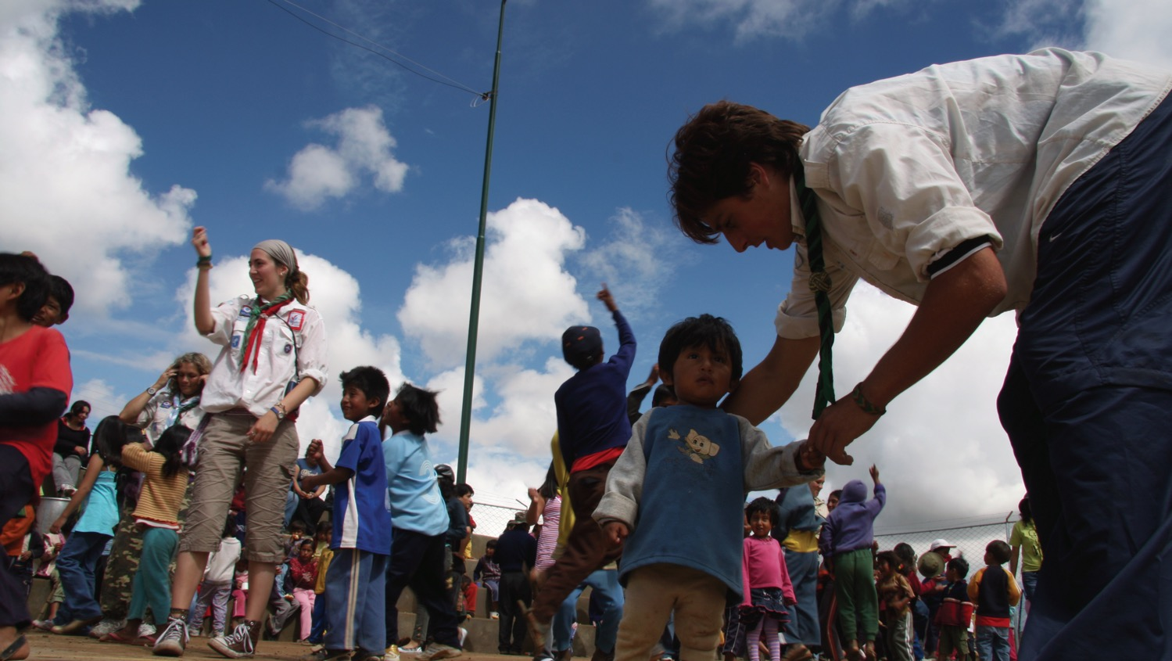

Once you have completed both an SW Discovery and an SW Voluntary Service and joined the Network, you may now receive the SW Award.
Notes:
Congratulations! It is the only award by WOSM for young people! This challenging award acknowledges your efforts and your learning experience. It also recognises you as an active world citizen capable of understanding global challenges and contributing locally to the improvement of our world. Think global, act local!. You will continue caring and taking action to create a better world.

Slide 27
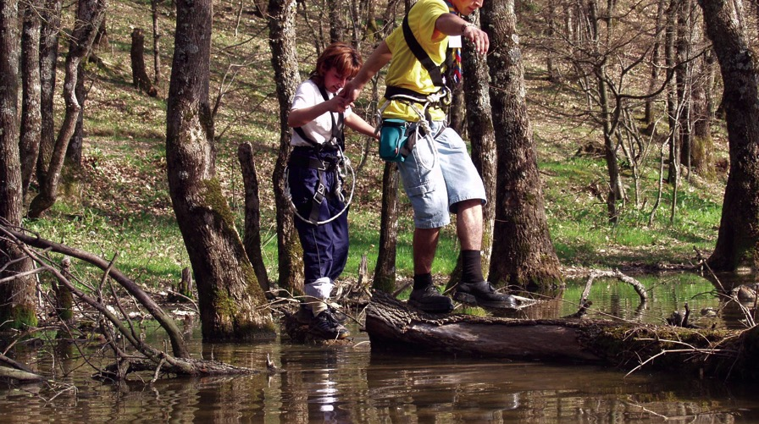
The SW Award - Criteria
Your personal involvement in the SW Discovery and your SW Voluntary Service.
Your ability to analyse issues of development, peace, or environment; and the challenges they represent for the future of society at local, national, and world level.

Slide 28
The SW Award - Criteria
The knowledge, skills, attitudes, and values you have acquired as well as your state of preparation to continue to work on development, peace, or environmental matters.
Your motivation to make a difference in serving the community and in contributing to making the world a better place.

Slide 29
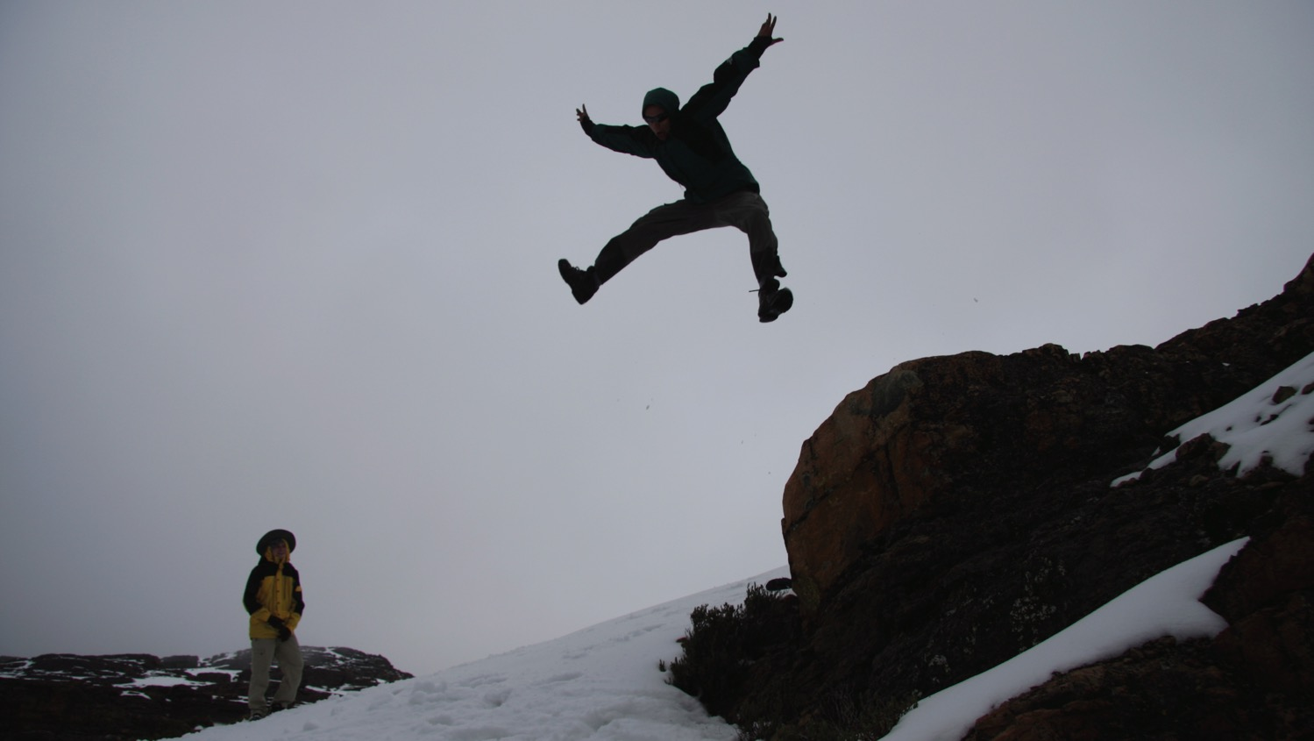

SW Award Badge
Notes:
It consists of a field of royal purple bearing the white fleur-de-lys surrounded by a white rope in a circle and a central reef knot at the bottom. The three red circles that surround the World Scout Emblem represent the three areas of action of the SW Award: development, peace, and the environment.
The world map, as the background of the badge, represents the actions that young people are taking worldwide in the three chosen fields as part of their SW Award. It also represents that this award is world-recognised, the highest award that a Scout can receive. Around the edge of the badge is the additional element of the name of the SW Award Programme in both official languages: English and French.

Slide 30
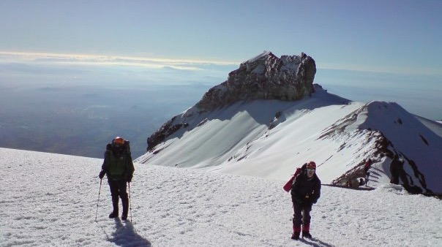
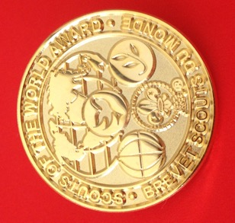
SW Award Pin
This badge has also been adapted into a gold pin for Awardees to wear if they are not a Scout or want to continue wearing the award on a different uniform when they become a leader or move on from Scouting.

Slide 31
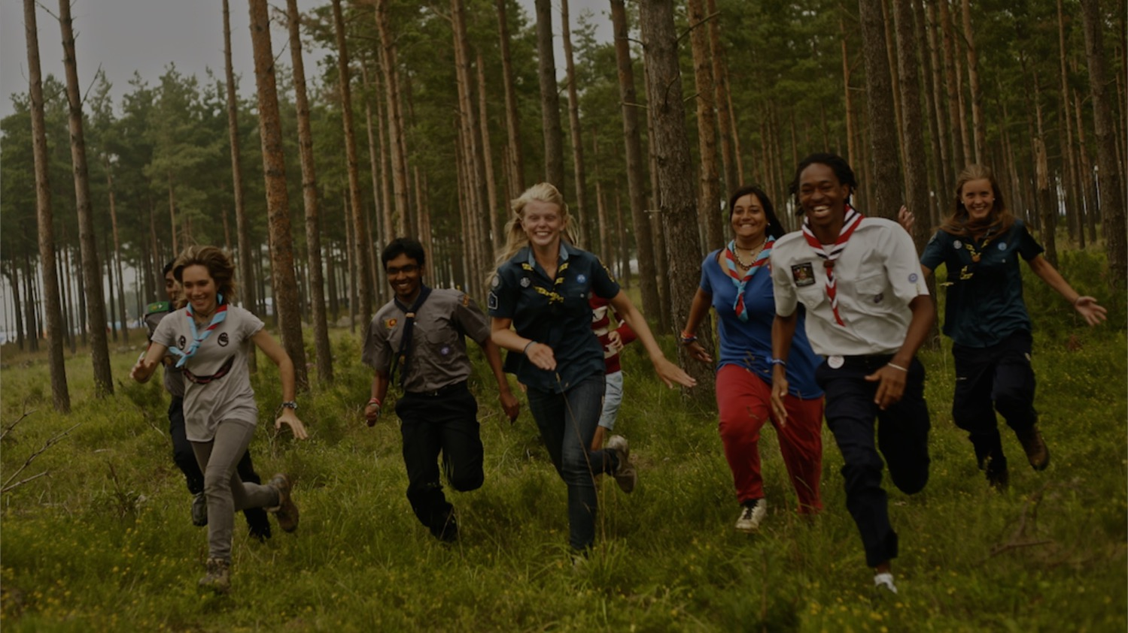
Thank You

