Slide 1


Slide 2
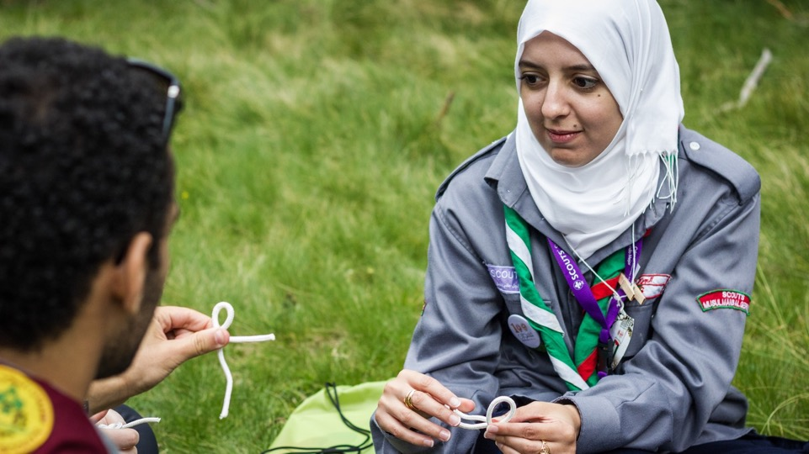

Renewed Approach
to Programme
YOUTH PROGRAMME

Slide 3
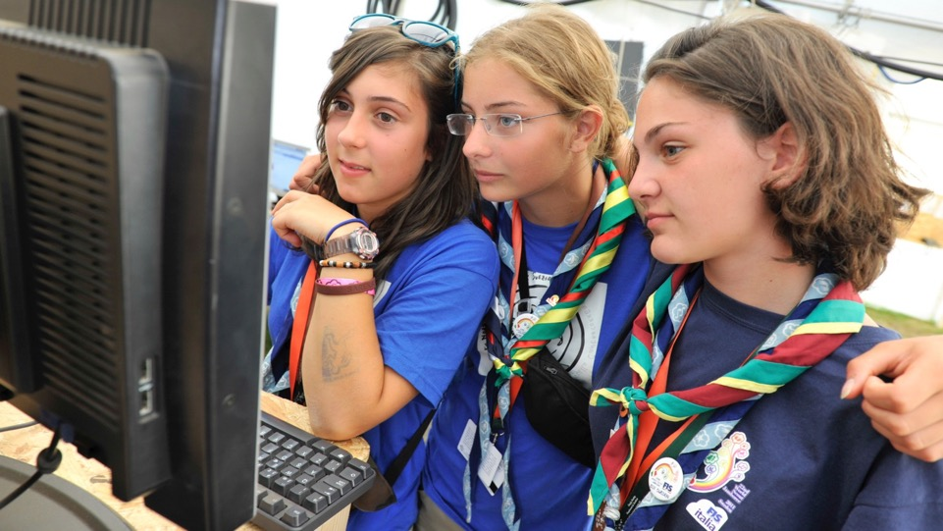
Objectives
To explain the youth programme and its life cycle
To recognize the importance of renewing the youth programme
To identify the eight steps of RAP tool

Slide 4
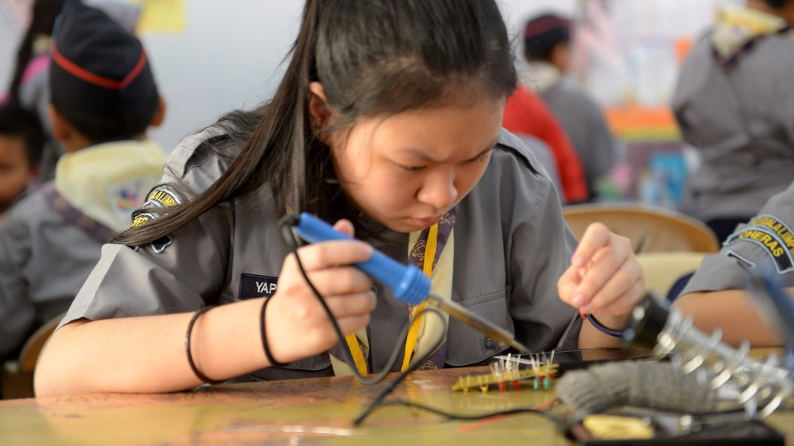
The Youth Programme in Scouting is the totality of the learning opportunities from which young people can benefit (What),
created to achieve the purpose of Scouting (Why),
and experienced through the Scout method (How).
Youth Programme
Definition

Slide 5
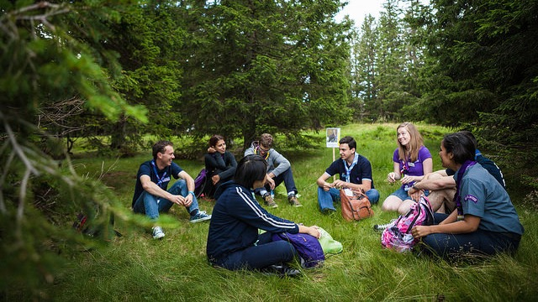



Youth Programme
Life cycle
Process of
Youth
Programme
development
Implementation
of the
Youth
Programme

Slide 6

Process of
Youth Programme development
A
R
RACE
C
Reflection
Analysis
Consideration
Evaluation
E
Notes:
Reflection on the purpose, principles, and method of Scouting
Analysis of recent trends in the needs and interests of young people, as well as the society in which they live
Consideration of the aims, objectives and priorities of the NSO
Evaluation of practical experience with the current Youth Programme

Slide 7

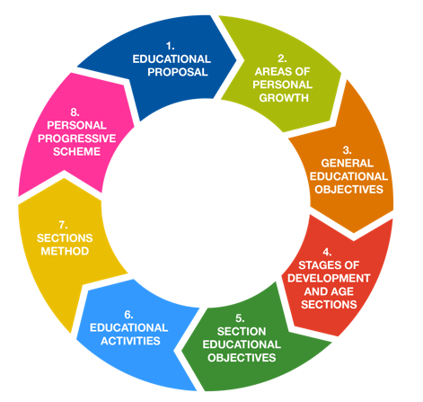
Process of
Youth Programme development
RAP

Slide 8

The
implementation
of the Youth
Programme
Adult training
Educational Materials
Scout Method
Partnership between
Adults and Youth

Slide 9
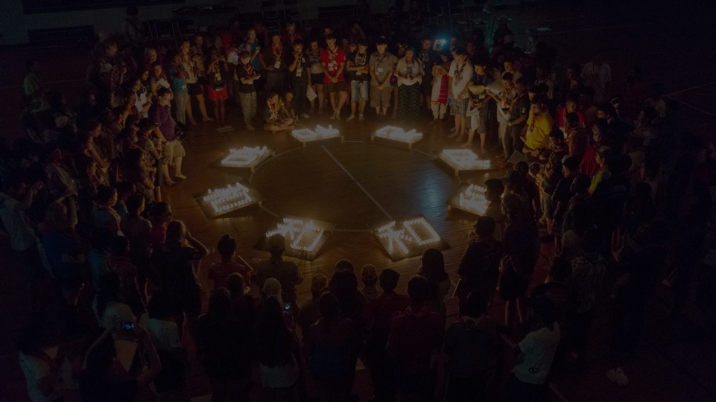




Roles and responsibilities
The
implementation
of the Youth
Programme
Developer
Facilitator
Supporter
Youth
Programme

Slide 10
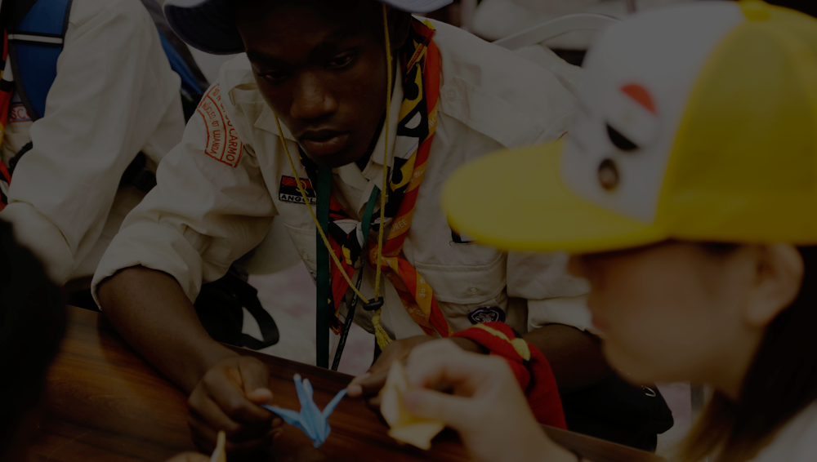
7
Have young people at its centre
Be about Education
Develop Active Citizens
Be locally adapted and
globally united
Be up-to-date and relevant
Be open to all
Be attractive, challenging,
and meaningful
Key Principles
for the Youth Programme

Slide 11
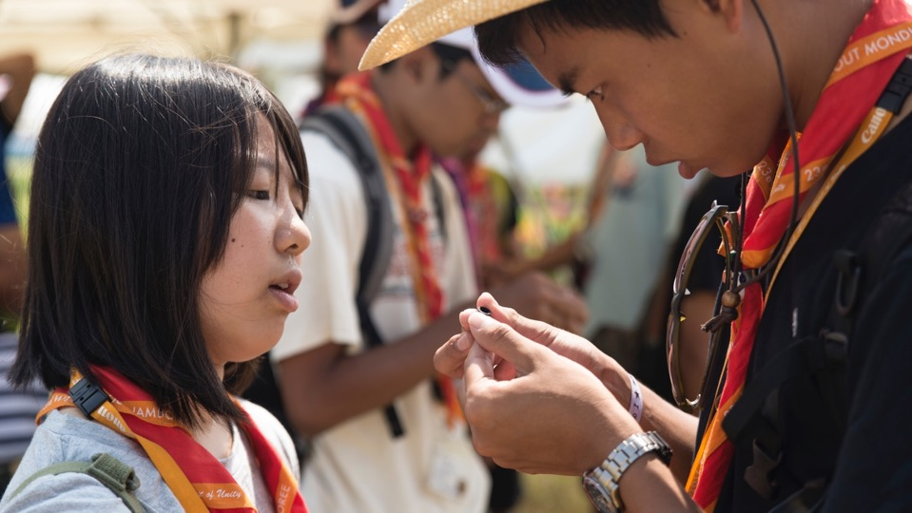

RAP

Slide 12
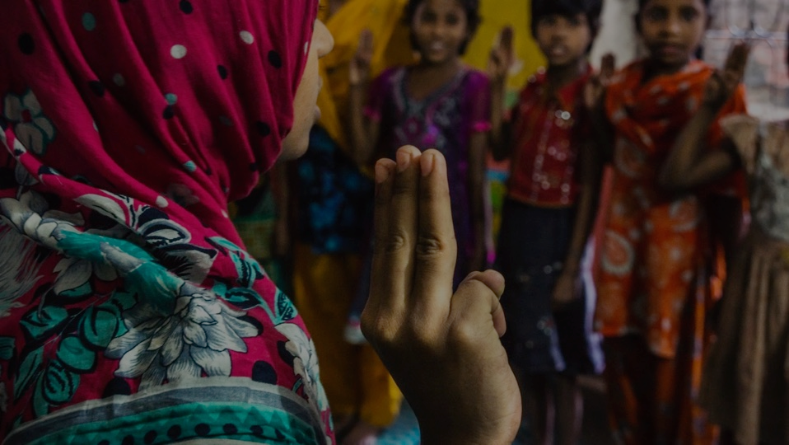
World Level
Niveau Mondial
Fundamentals
Fondamentaux
From the fundamentals to programme implementation
Needs and aspirations of young people
Besoins et aspirations des jeunes
National Level
Niveau National
Programme Development
Développement du programme
County, district
Région, district
Youth Programme Dissemination
Diffusion du programme
Needs and aspirations of young people
Besoins et aspirations des jeunes
Local Group
Groupe local
Youth Programme Implementation
Mise en œuvre du Programme
Notes:
Diamond: the diamond of Scoutign

Slide 13
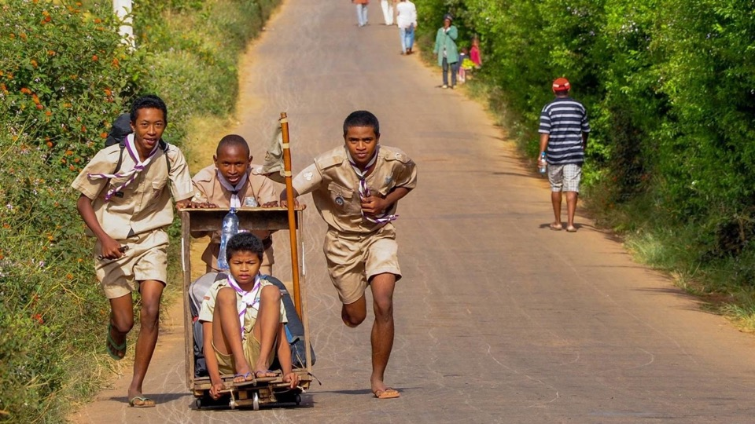
How to use RAP?

Slide 14
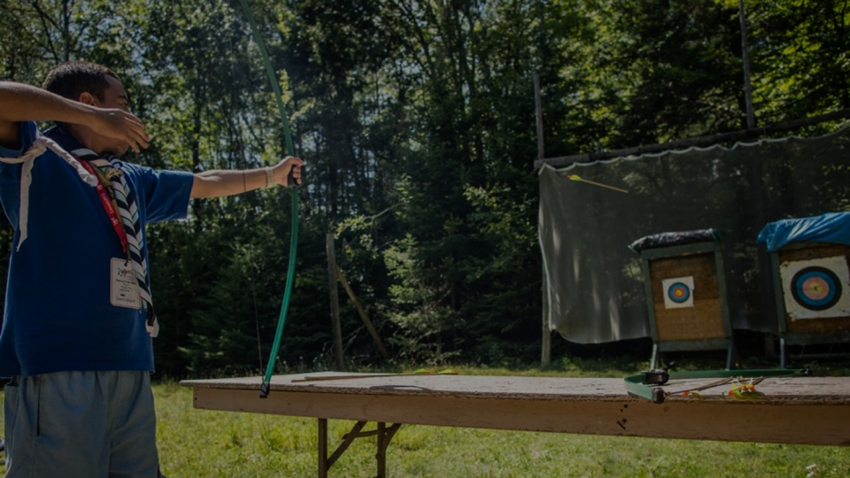
Progressive scheme
3. Methods
Section methods
Activities
2. Organising
Age Sections
R
Section
Educational
Objectives
S
C
General educational
Objectives
1. Setting Goals
Areas of growth
Educational Proposal

Slide 15
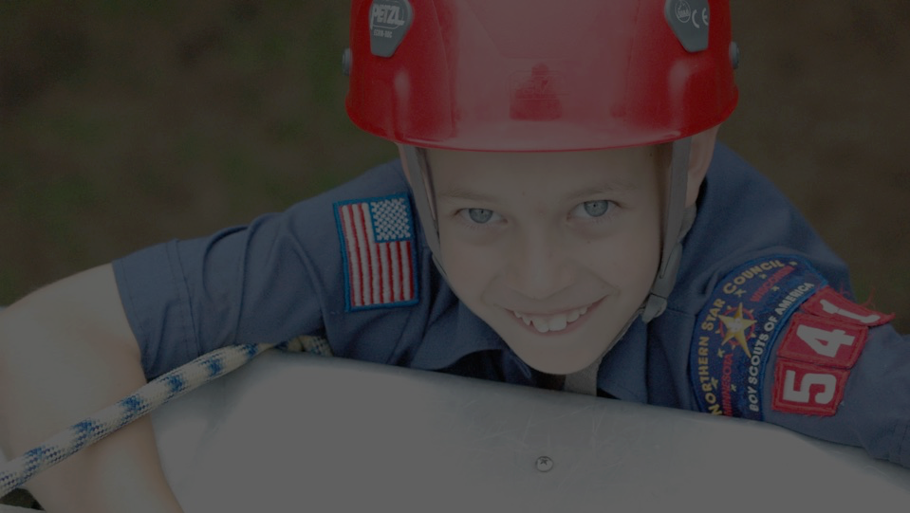

The mission of Scouting is to contribute to the Education of young people through a value system based on the Scout Promise and Law, to help build a better world where peolple are self-fulfilled as individuals and play a constructive role in society.
Mission of Scouting, WOSM

Slide 16

what are we trying to do
we are not the only influence on young people
open to all
The mission of Scouting is to contribute to the education of young people through a value system based on the Scout Promise and Law, to help build a better world where people are self-fulfilled as individuals and play a constructive role in society.
expressing the values on which Scouting is based
not just academic, a life long process
what we believe and stand for
together with others
A social dimension: active and supportive
better people= better world
A personal dimension: having achieved one’s full potential
Local,national and international

Slide 17
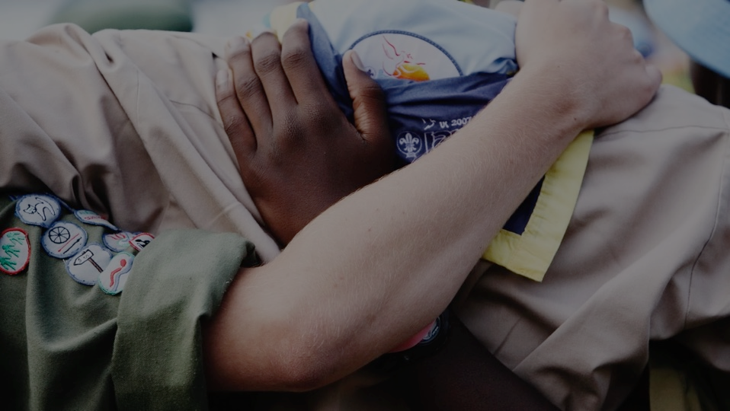


A whole, the human personality
Spiritual
Character
Affective
Social
Physical
Intellectual
6 areas
interacting
with each others

Slide 18



An educational objective is a result expected at the end of an educational process and expressed in terms of new abilities to be acquired

Slide 19
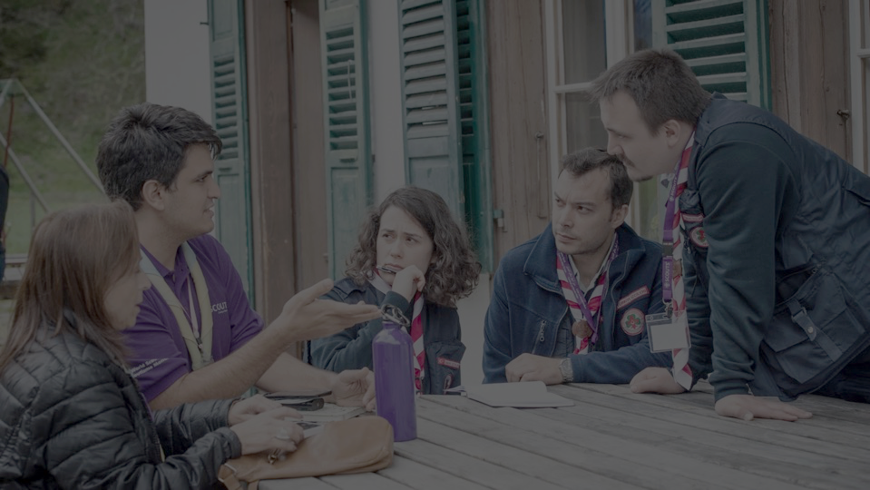
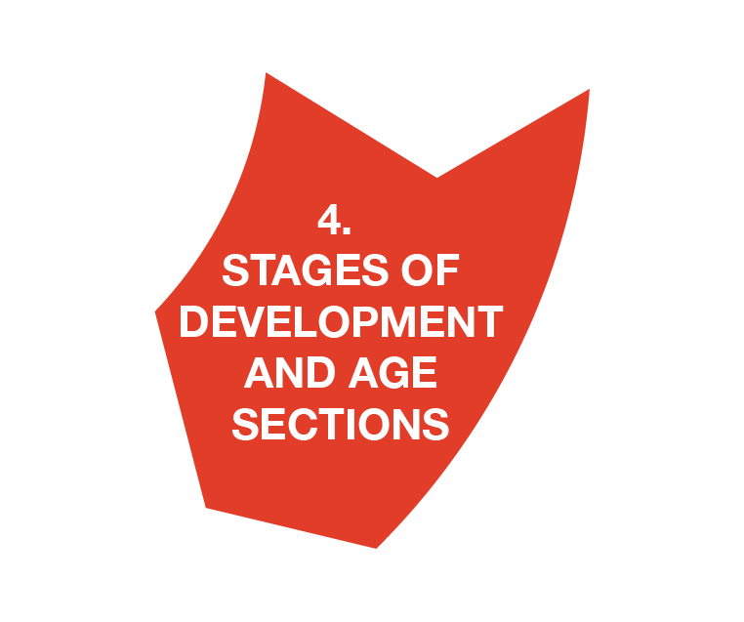
At this difficult age, what is good for an adolescent of sixteen is not so good for a boy of fifteen and may be bad for one of thirteen of fourteen…
Even though Scout education has the same four ambitions for older and younger boys (character, manual skills, health, altruism), the details of the action vary according to the different stages of development of the child.
Baden-Powell, Aids to Scoutmastership

Slide 20
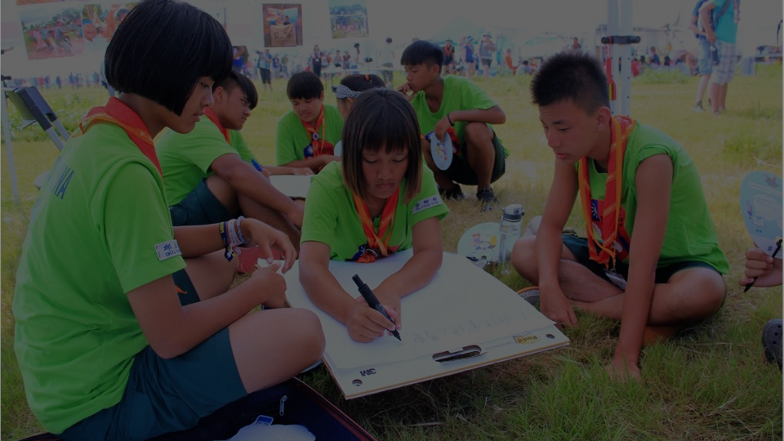
Age section models
Cubs
Scouts
Rovers
5
6
7
8
9
10
11
12
13
14
15
16
17
18
19
20
Cubs
Scouts
Pioneers
Rovers
5
6
7
8
9
10
11
12
13
14
15
16
17
18
19
20
Beavers
Cubs
Scouts
Venture Scouts
5
6
7
8
9
10
11
12
13
14
15
16
17
18
19
20

Slide 21
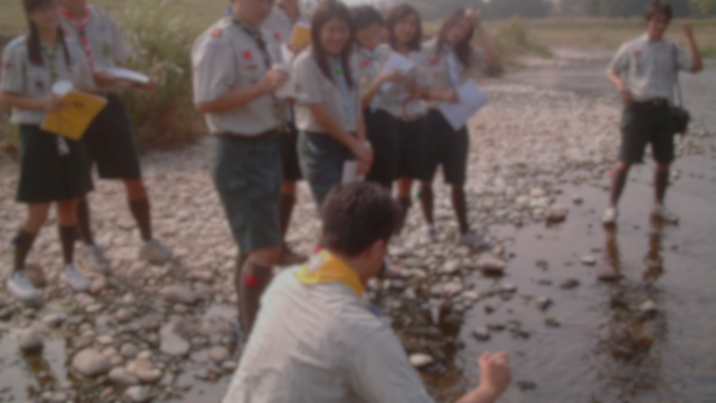

Cubs
Scouts
Rovers
Objective 1
Objective 1
Objective 1
Objective 2
Objective 2
Objective 2
General Objective
Objective 3
Objective 3
Objective 3

Slide 22

How to develop section objectives
Curiosity, Exploration,
Investigation, Observation
General Objective (Rover section)
Develops one ’s sense of curiosity and systematically
collects information to expand one ’s knowledge
Section Objective (Scouts)
Shows an interest in expanding his/her knowledge of
things going on around him/her
Educational trail: Collecting information
Section Objective (Cubs)
Is able to express what he/she finds surprising
or strange

Slide 23
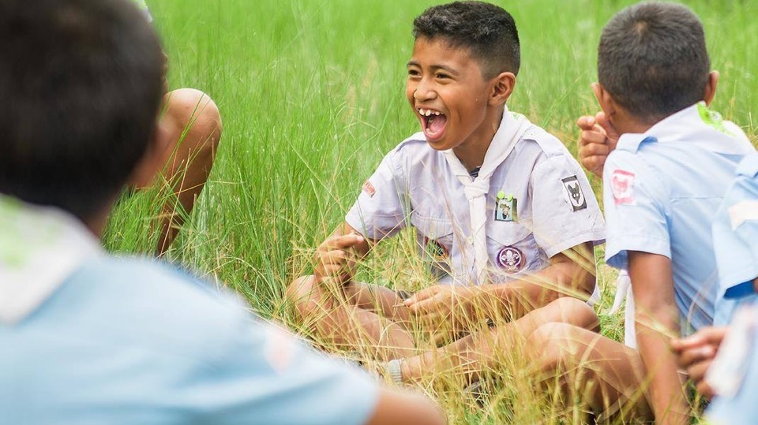





Slide 24
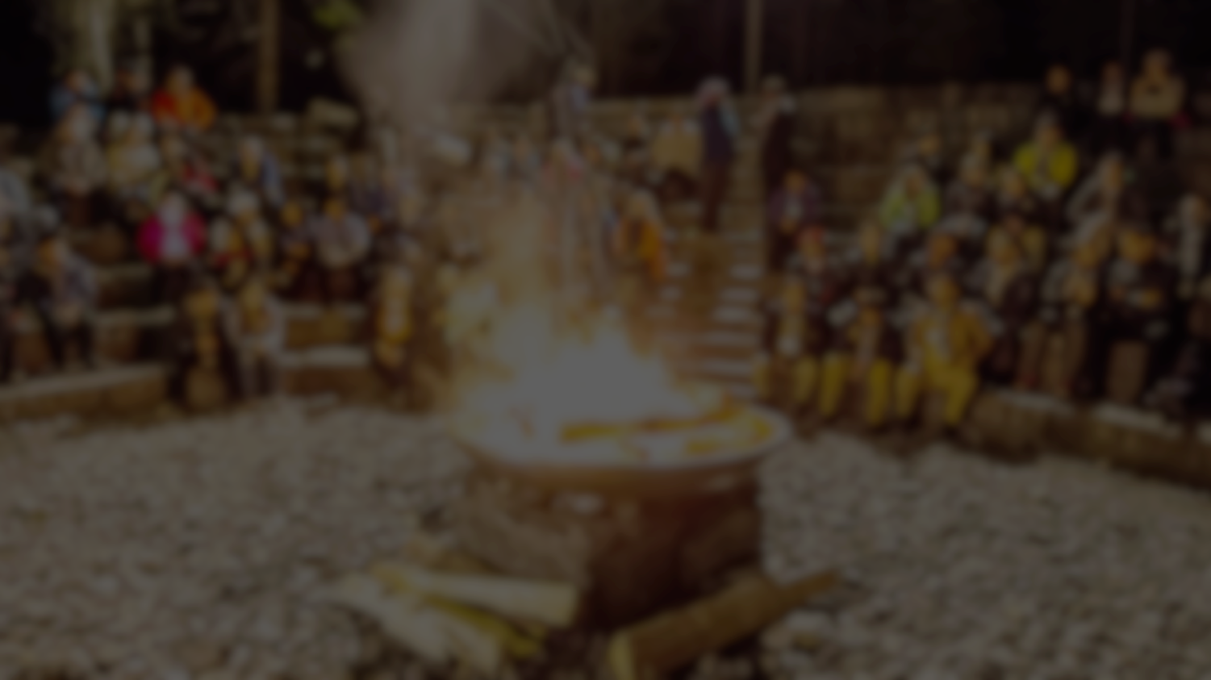

Project
Youth
involvement
Participative activity
Directed activity
Duration and complexity

Slide 25
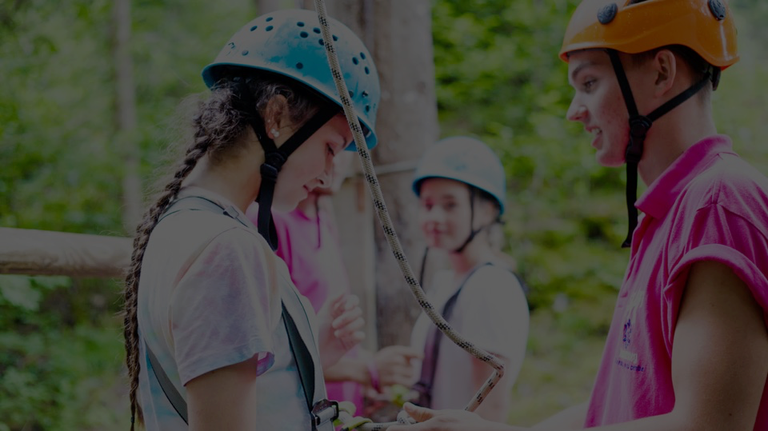
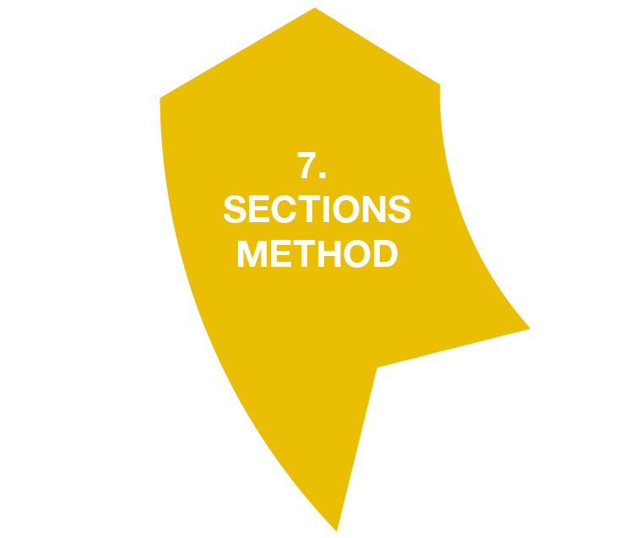
« Play is the first Great educator »
« Scouting is a Jolly Game »
Baden-Powell

Slide 26


Spontaneous game

Slide 27
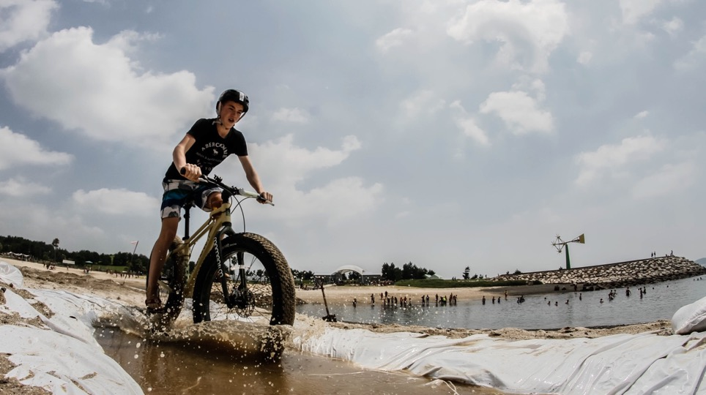










Notes:
The strategy document provides clarity on the priorities and purposes of WOSM (World and Regional) CSE activities. It also aims to provide a framework for NSOs on core issues such a brand, core messages and key activities that will maximise impact with limited resources.

Slide 28
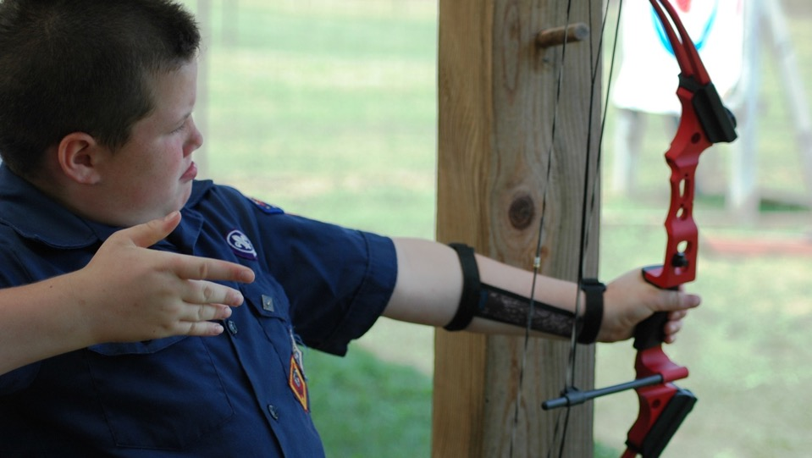

Focused on each individual
« Our goal should be to develope, in each young person, ambition and hope, and the sense of achievement which will carry him on to greater ventures » (B.P)
Considering each person’s strengths
Based on educational objectives

Slide 29

All section educational objectives are achieved
Final stage
Developing section
educational objectives
Half of the section educational objectives are achieved
Intermediate
stage
Proficiency badges
Discover Scouting’s proposal, Decision to make a personal commitment (Promise)
Welcome
stage

Slide 30
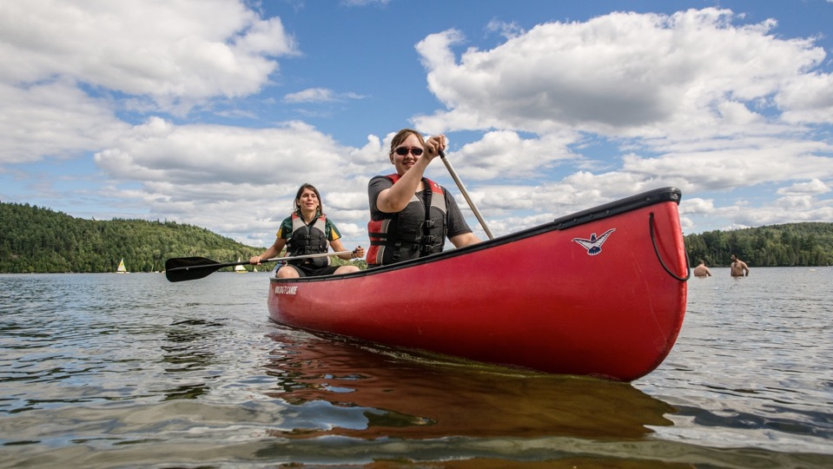
RAP

Slide 31
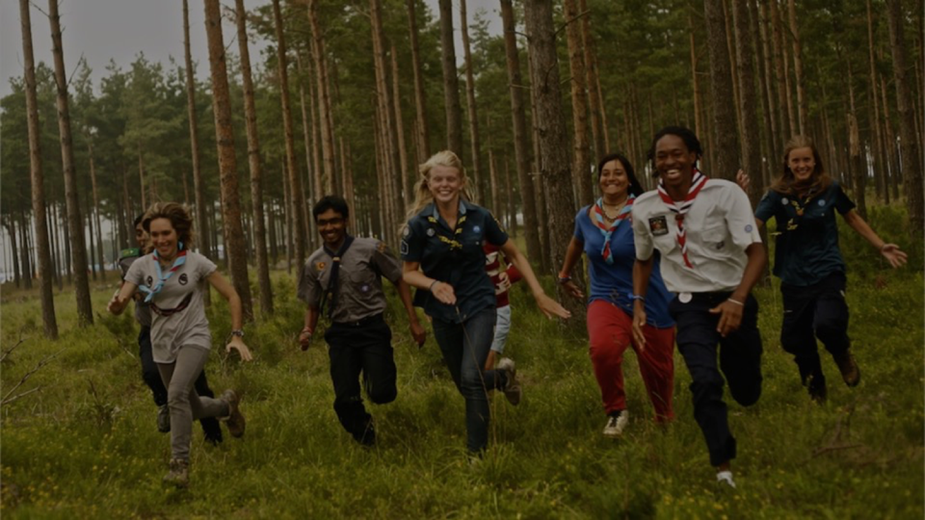
Thank You

