Slide 2
MoP INITIATIVE GOALS
Goal 1 The Culture of Peace
Goal 2 The Culture of Dialogue
Goal 3 Social Actions to achieve the SDGs
Goal 4 Strengthening the Global Network
© World Scout Bureau Inc.
2

Slide 3
Programme
Fund
Network
3 MoP
Elements
© World Scout Bureau Inc.

Slide 4
Programme
Fund
Network
Provide an educational and engaging experience to young people

Slide 5
Programme
Fund
Network
Inspire and support local actions
Amplify social impact globally
Provide an international experience.

Slide 6
Programme
Fund
Network
Support community development actions,
and
NSO/NSA capacity development.
Notes:
Just a start slide

Slide 7
Programme
Fund
Network
3 MoP
Elements
Notes:
Just a start slide

Slide 8
Programme
Fund
Network
Let’s get hands on with
Notes:
Just a start slide

Slide 9

Messengers of Peace is part of the…
… contributing in the achievement of the Sustainable Development Goals

Slide 10

The Planet Plan,
supported by Messengers of Peace…
Notes:
Here is the areas of action … just to show what is the current agreed fields of actions in the world by the united nations. It is not the only but there is a lot of resources around it

Slide 11


Slide 12













An many more…

Slide 13
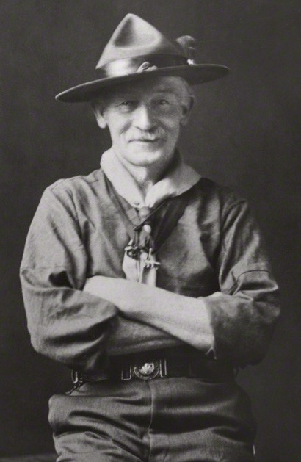
A dream…
“… a Universal brotherhood of service…
where the young citizens, male and female in all countries,
are brought up to look upon their neighbours as brothers and sisters in the human family
allied together with the common aim of service and sympathetic helpfulness towards each other… ”
1st World Scout Conference Sir Robert Baden-Powell (Chief Scout)
Notes:
It is part of BP in the 1st Conference … where he dreamed of a Universal brotherhood of service

Slide 14
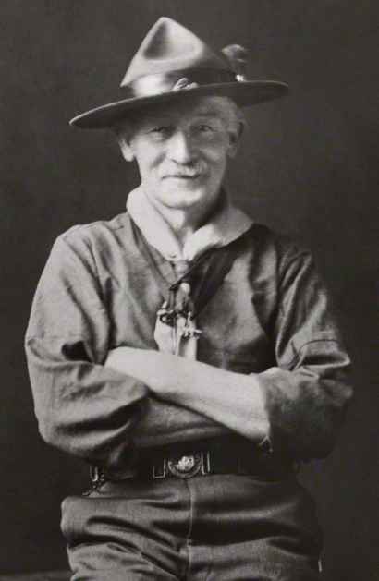
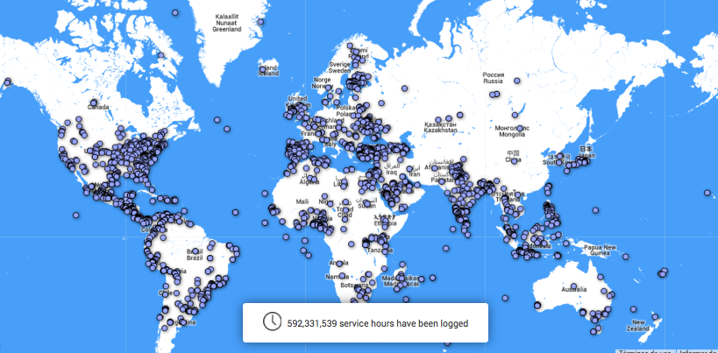
A reality…
“… a Universal brotherhood of service…”
Notes:
The dream become true

Slide 15

EDUCATIONAL PROGRAMME
Notes:
What is MoP programmes

Slide 16


The Culture of Peace is a set of values, attitudes, traditions, and behaviors.
Possible if we…
Scouts
and the
Culture of Peace
With the support of…

Slide 17
Scouts are Messengers of Peace
because our values
drive us to take action
to…
RESPECT
right to development
environmental needs
cultural & linguistic diversity
fundamental freedoms
freedom of expression, opinion, and information;
life
human rights
sovereignty, territorial integrity, independence
PROMOTE & PRACTICE
dialogue
pluralism
tolerance
justice
cooperation
democracy
understanding
peaceful & non-violence
settlement of conflicts
solidarity
equal opportunities for women and men
EDUCATE
Declaration of a Culture of Peace, United Nations 1999

Slide 18
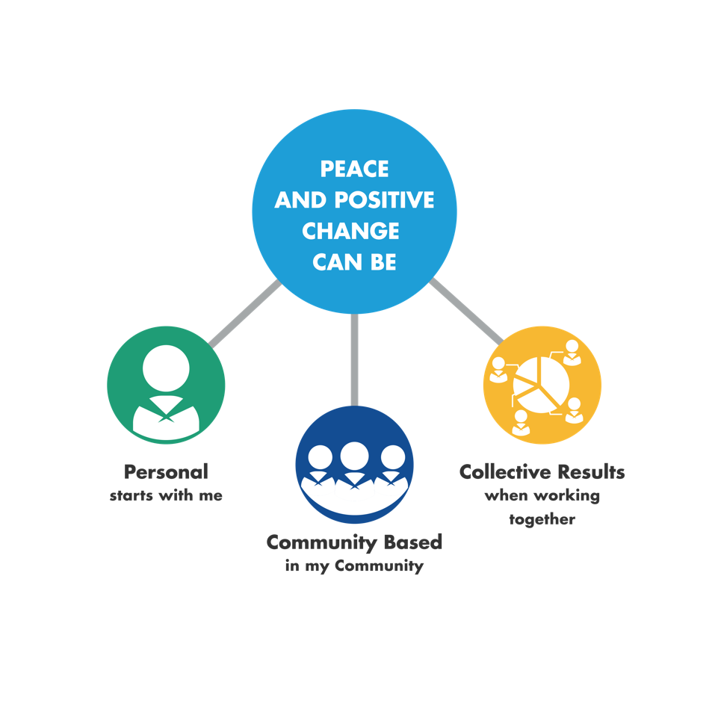
3
Dimensions
how Scouts build a Culture Of Peace

Slide 19
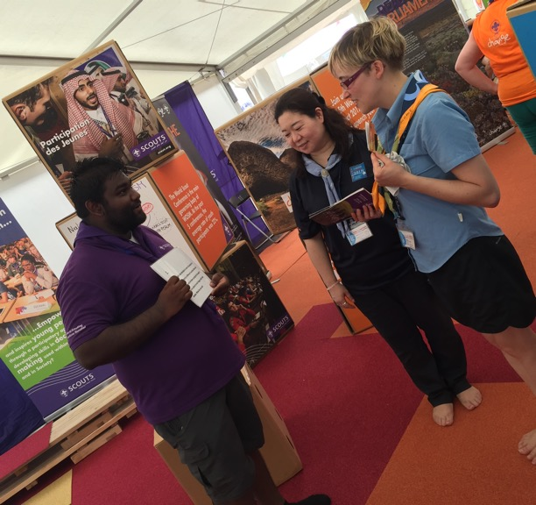
4
Easy steps to Become a
Messenger Of Peace

Slide 20
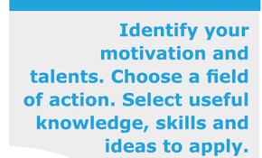

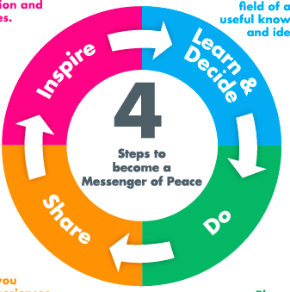



Slide 21
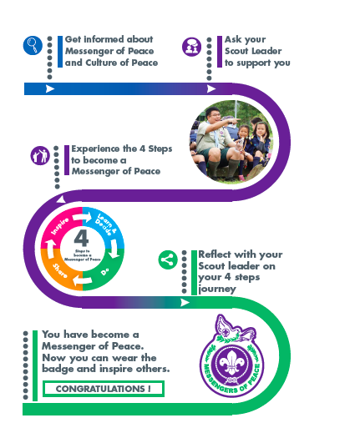
How to get your Messengers of Peace Badge

Slide 22
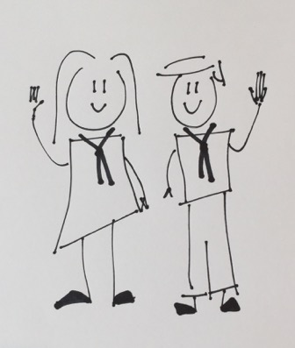

Scout Leader
Online Community
Local Community

Slide 23
Scout Leader
Online Community
Local Community
Youth Prog.
Team NSO

Slide 24
Scout Leader
Online Community
Local Community
Youth Prog.
Team NSO
WOSM MoP Team

Slide 25
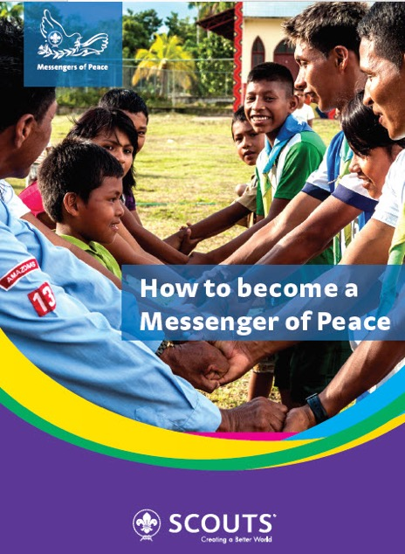
Hands on Booklet “How to Become a Messenger of Peace”
Notes:
Jonathan

Slide 26
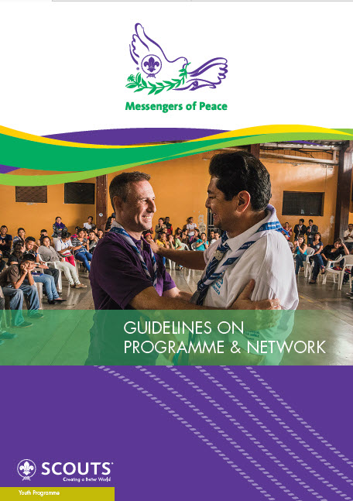

Guidelines for National Scout Organizations and Programme Developers
Notes:
Jonathan

Slide 27


Messengers of Peace Partners
Notes:
Partners with MoP

Slide 28
NETWORK
Notes:
What is MoP programmes

Slide 29
Let’s join the Network…
“… a Universal brotherhood of service…”
Notes:
The dream become true

Slide 30
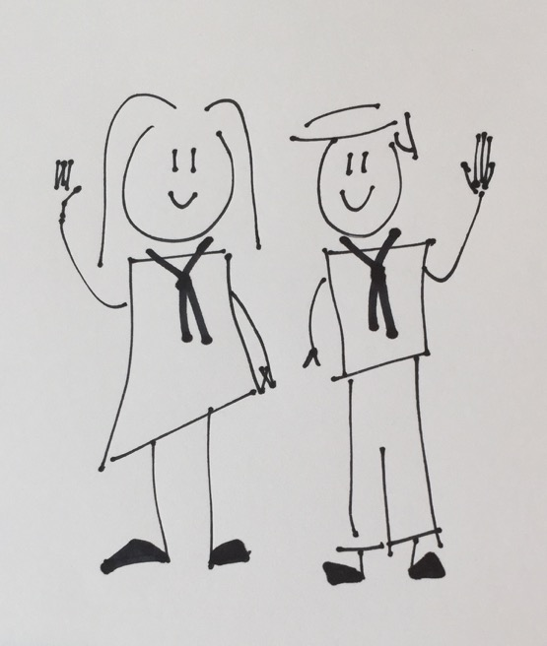
Ana
Omar

Slide 31



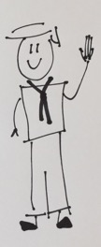


Slide 32
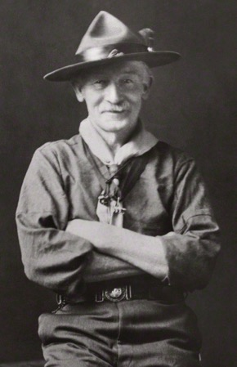
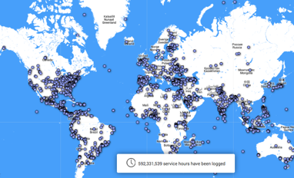
Ana
Omar

Slide 33
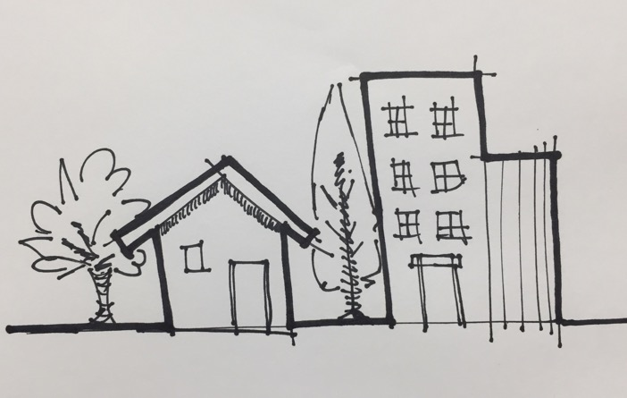
Drugs
Migration
Exclusion
Violence
Unemployment

Slide 34
Positive Impact
Drugs
Migration
Exclusion
drugs & violence
Violence
Unemployment

Slide 35
Network empowers

Slide 36
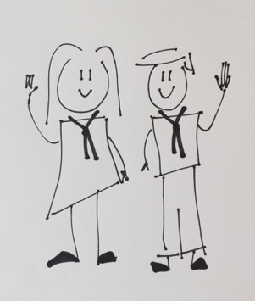
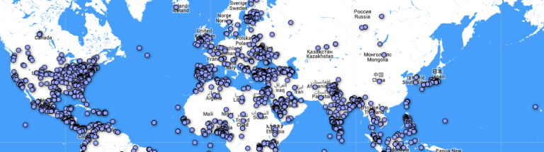
Human network
in the field, joining efforts, inspiring face to face, disseminating information and practical resources.
Virtual network sharing stories of success, exchanging experiences, asking for support or resources, and inspiring people with their ideas.
“A UNIVERSAL NETWORK OF SERVICE”
Many small teams – of Scouts and non-scouts- integrate a worldwide network.
Notes:
The dream become true

Slide 38





Slide 39






Scouts Global Network
What's app
facebook
twitter
www.scout.org

Slide 40

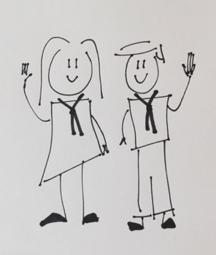
“Ana and Omar
are the main actors and drivers of Peace…
Notes:
The dream become true

Slide 41

Scouts Global Network
Human network connected
online
With international collaboration
Inclusive for
local community members
Starts at
local level
Unites Scouts
common purpose
NSOs tailor
own model

Slide 42
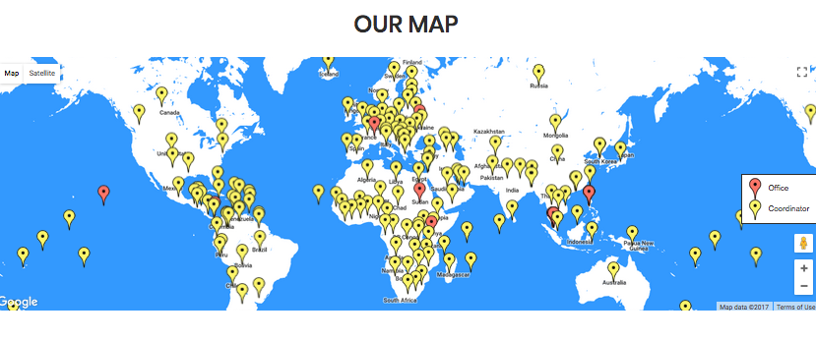
scout.org/messengersofpeace
Messengers of Peace Ambassadors
www.scout.org

Slide 43
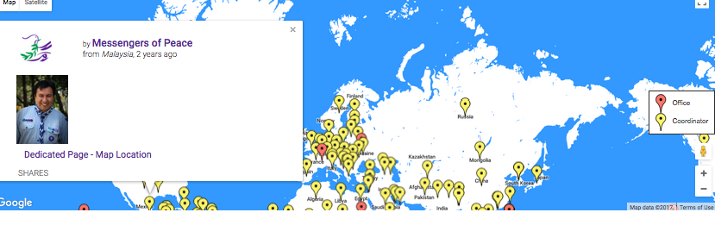
scout.org/messengersofpeace
Messengers of Peace Ambassadors
www.scout.org

Slide 44
Ana
Contact the Global Network for support…
Omar

Slide 45
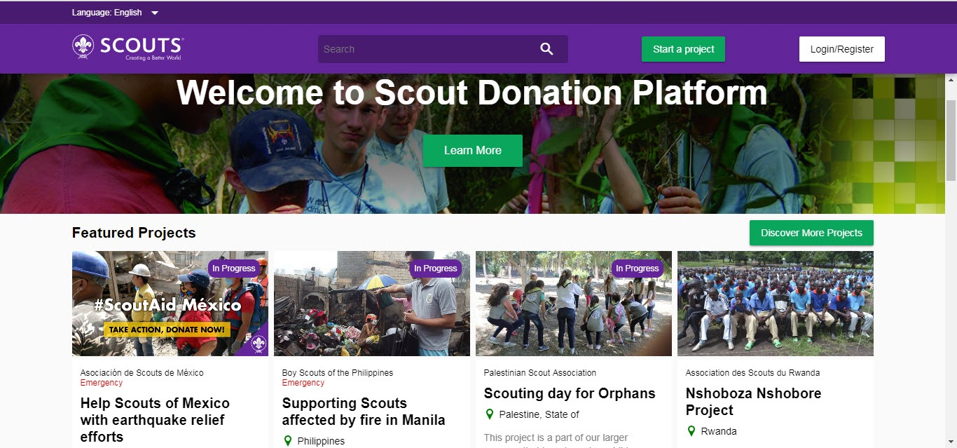
scout.org/donate
Notes:
May

Slide 46
PLANING OUR IMPACT
Notes:
What is MoP programmes

Slide 47
We want to demonstrate our impact!!!
Relevant
Realistic
Resources
…so we need to Monitor and Evaluate our actions and projects
Notes:
The dream become true

Slide 48
Monitoring And Evaluating Our Impact
Are people more aware about Peace Culture or SDG’s?
What SDG’s are we contributing to?
How many MoP Badges have been presented?
How many Ambassadors do we have?
How many partners are contributing with Scouts initiatives?
How many promotional activities are carried on?
How many people are we inspiring with our stories?
Notes:
The dream become true

Slide 49
Thank you

