Slide 1
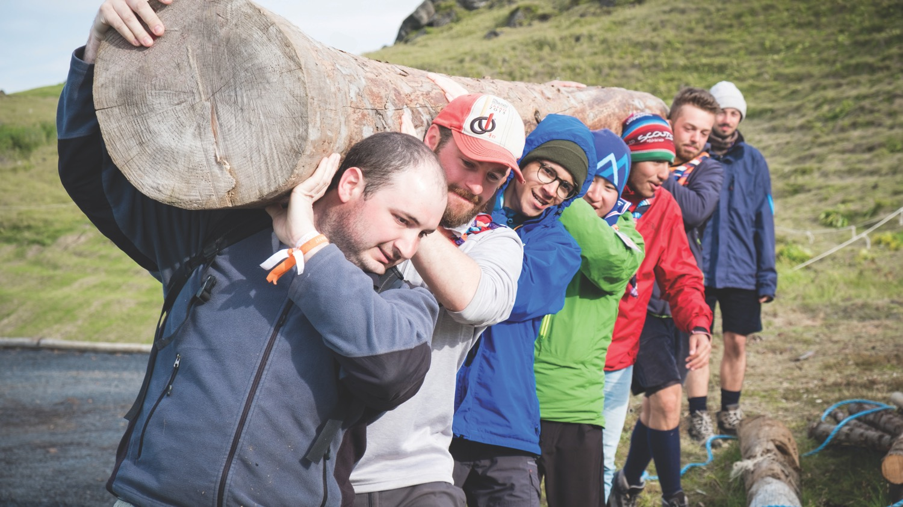

Adults in Scouting World Policy
ADULTS IN SCOUTING

Slide 2

Millions of adults
Scouting could not have existed around the world without millions of adults, the majority of them volunteers, that currently support the Movement by performing a wide range of roles or functions.

Slide 3

Systematic approach
Adults in Scouting is a
systematic approach for supporting adults
to improve the effectiveness, commitment and motivation of the adult leadership
so that better programmes are supported in the delivery by and for young people.

Slide 4
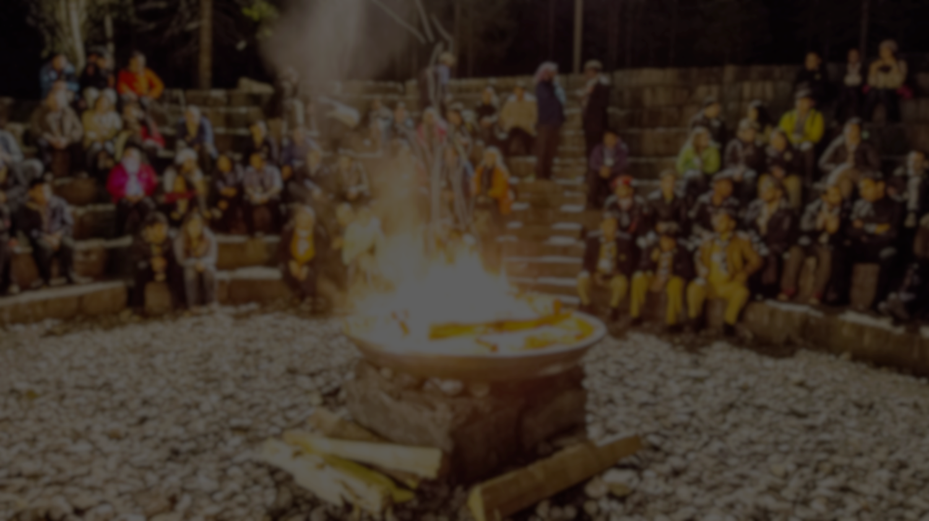
Strong link with …
Adults
in Scouting
Adults in Scouting is one of the three strategic areas that constitute an effectively functioning NSO:
YOUTH PROGRAMME
ORGANISATIONAL DEVELOPMENT

Slide 5




Strategic outcomes:

Slide 6

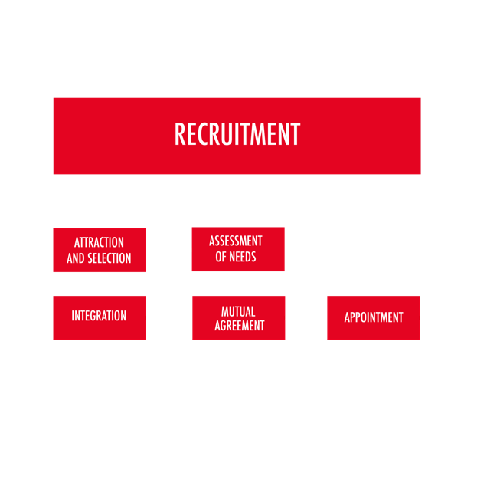
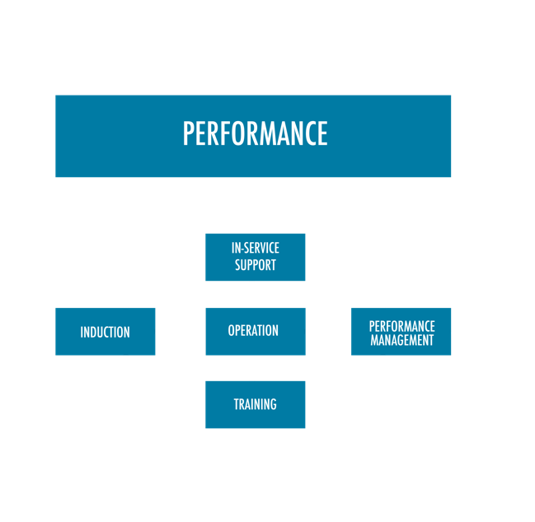
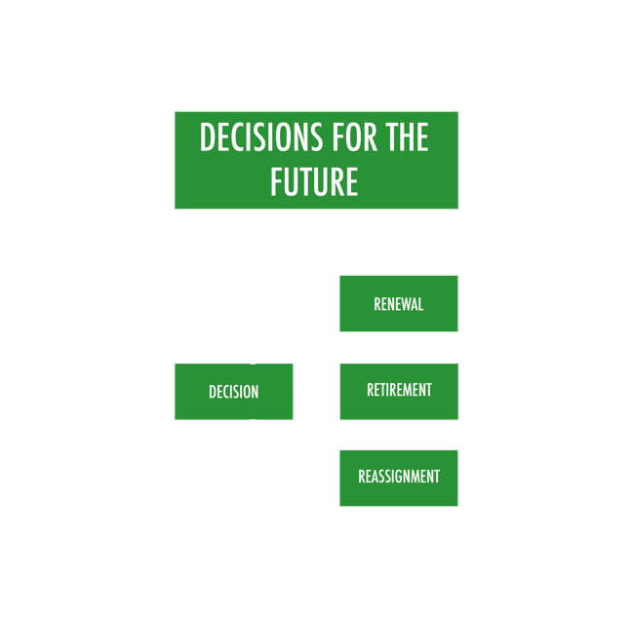

The adult life cycle

Slide 7

Recruitment
Recruitment is a process of sourcing volunteers or employed staff for the purpose of accomplished different work, tasks, job or function required by the organisation.
Steps in the the recruitment:
Assessment of needs
Attraction and selection
Integration
Mutual agreement
Appointment

Slide 8

Performance
Performance is the action or process of performing a task or function. For the good performance next elements are crucial:
Induction
Training system
Operation
In-service support
Performance management
Performance management is a continuous, comprehensive and natural process which clarifies mutual expectations and the support required.

Slide 9

Decisions for the future
Adult in Scouting policy strongly advocates mobility and flexibility across the roles and functions. That enables more opportunities to participate at all levels.
Possible decisions for the future are:
Renewal
Reassignment
Retirement
Decision for the future enable good HR management and help members to stay motivated for further commitments.

Slide 10
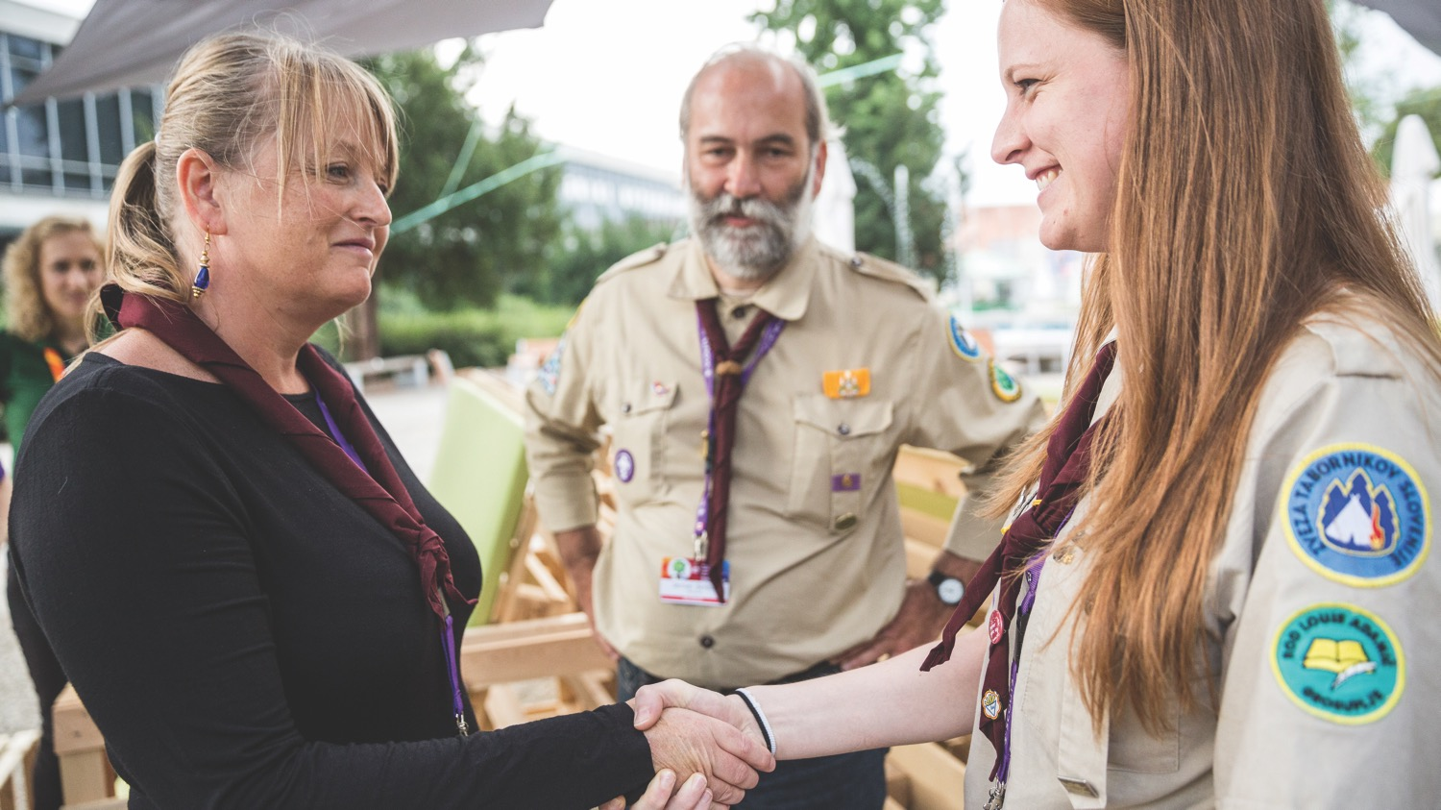
Recognition
All members who have successfully delivered on their agreed commitment to their role or function should receive recognition.
Recognition should be permanent process based on demonstrated performance and personal progression, informal and formal, non-material and not only awards based.
Recognition is critical for increasing members’ engagement, leading to higher retention in the long run.

Slide 11
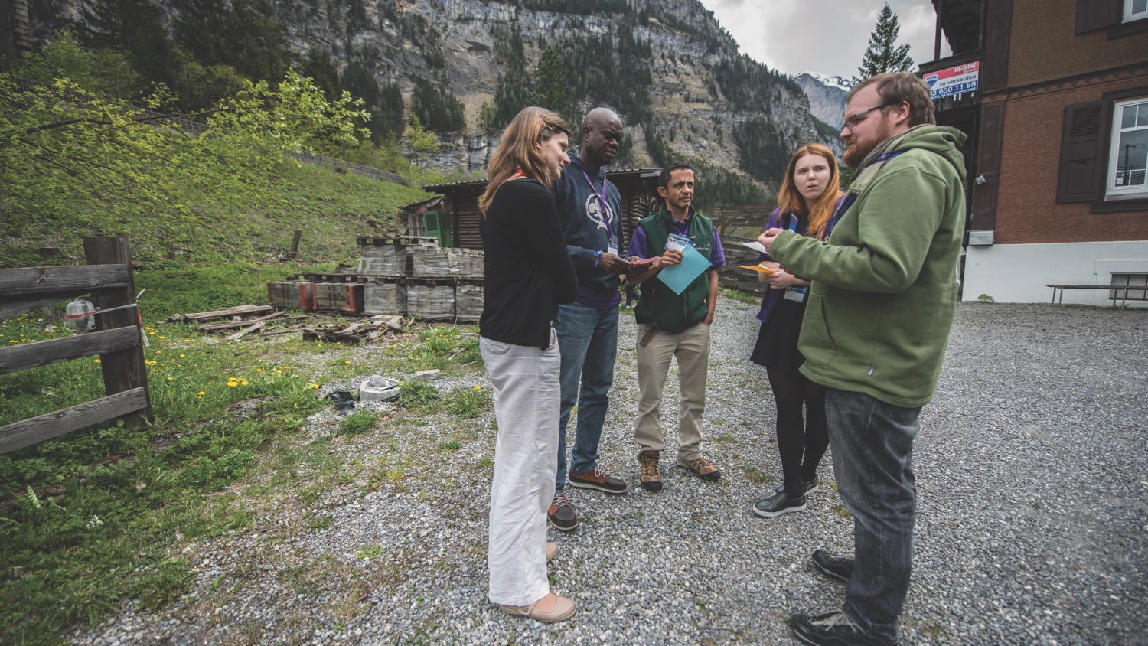
Retention strategy
For increasing the retention, adults in Scouting need to:
trust the organisation and feel that they are trusted, respected and supported,
feel a sense of commitment to the NSO,
access learning opportunities on a regular basis and continuously develop leadership competencies,
Adults need to receive a sense of achievement from their role or function in Scouting as well as being recognised for it.
NSOs should respond with clearly outlined retention strategies.

Slide 12

Triennial plan 2017 - 2020
Adults in Scouting
Strengthen the implementation of all aspects of the life cycle of Adults in Scouting (including recruitment, training and retention), in accordance with the World Adults in Scouting (AiS) Policy.
KPI: 80 NSOs will improve their internal processes for recruiting, training and retaining adult leaders, in accordance with the World AiS policy.

Slide 13

How Adults in Scouting Life Cycle is relevant for you?

Slide 14
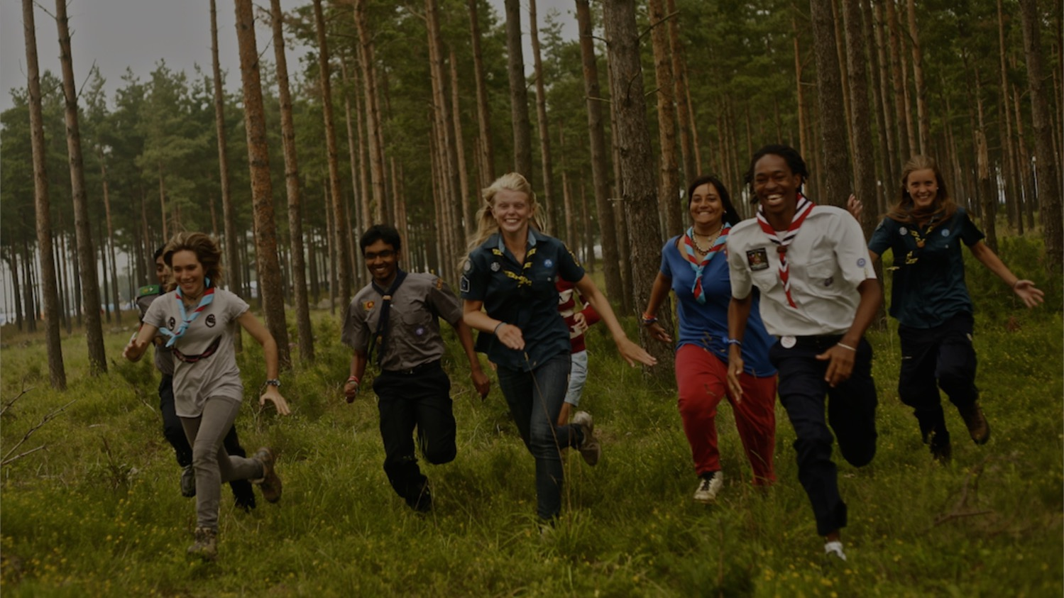
Thank You

